Slide 1
The Landscape Horticulture Profession:
Careers & Pathways
Notes:
Presenter Introduction
FOR THE PRESENTER:
Please feel free to add the following to a slide(s) / or on the cover slide
- Your company logo
- Pictures of some of your projects / achievements in the profession
- Pictures of you / your staff on-the-job
- Company contact information / brief personal bio

Slide 2
About Landscape Ontario
2,600 companies,
Over 70,000 FTE’s
Largest Voluntary Horticultural Trades Association in Canada
9 Chapters in Ontario
Ottawa, Upper Canada, Durham, Toronto, Golden Horseshoe, Waterloo, London, Windsor, Georgian Lakelands
Part of the Canadian Nursery Landscape Association (CNLA)
40+ Years of Experience as an Association
10 Sectors
Garden Center, Grounds Management, Grower, Interior Plantscape, Irrigation, Landscape Contractor, Landscape Design, Lighting, Snow & Ice Management, Turf Management
14.48 Billion national
economic contribution*
*Deloitte, 2009

Slide 3
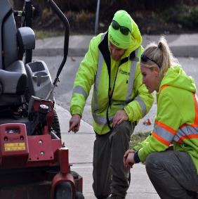
Protecting and Enhancing Lives
Designing, Building & Maintaining Green Infrastructure
Promoting Environmental Stewardship
Building Strong
& Vibrant Communities
Enhancing Quality of Life / Health & Wellness
Fulfilling & Diverse Life-Long Careers

Slide 4
Green Infrastructure
Green infrastructure is defined as the natural vegetative systems and green technologies that collectively provide society with a multitude of economic, environmental and social benefits.
Stormwater Mitigation
Green roofs & Living walls
Urban Agriculture
Urban Forests
Wetlands & Waterways
Parks & Open Spaces

Slide 5
LO Sector Groups
Grounds
Management
horttrades.com/sector
Interior Plantscape
Garden Centre
Turf
Management (IPM)
Snow & Ice
Management
Grower
Landscape
Contractor
(Hardscape &
Softscape)
Landscape
Designer
Lighting
Where Do You See
Your Career Growing?
Irrigation

Slide 6
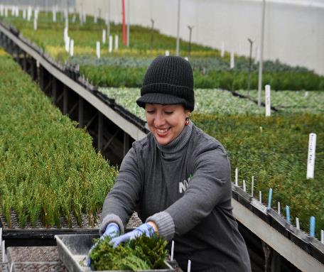
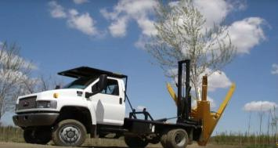
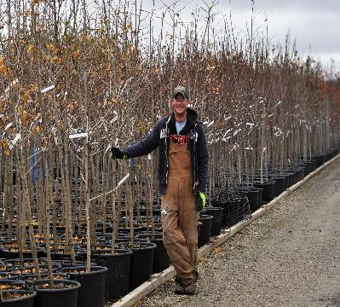
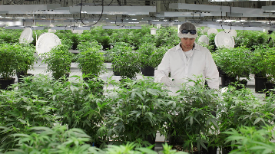
GROWER

Slide 7
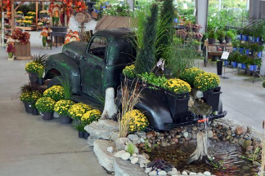
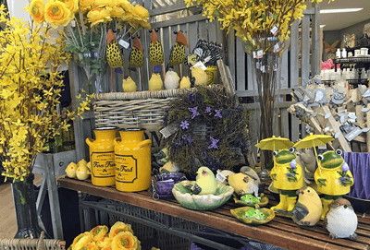
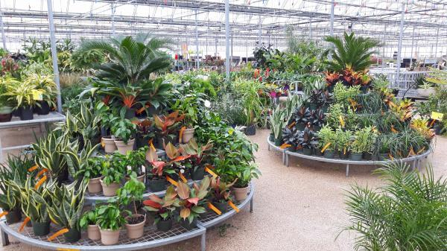
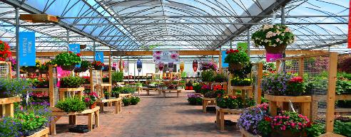
GARDEN CENTRE

Slide 8
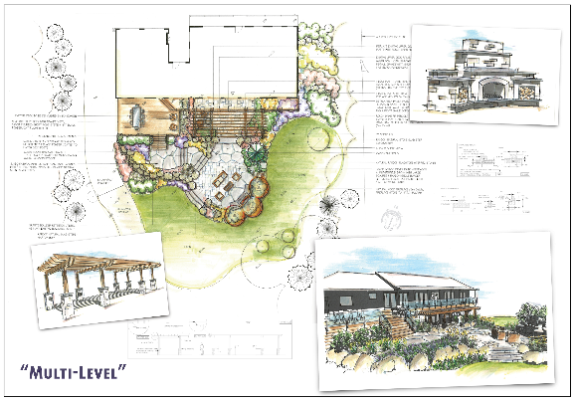
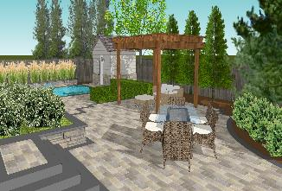
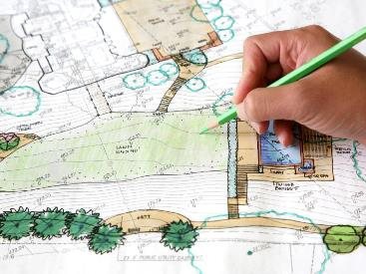
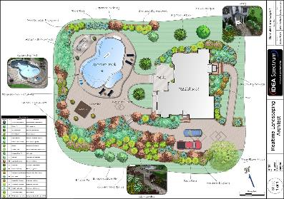
LANDSCAPE DESIGNER

Slide 9
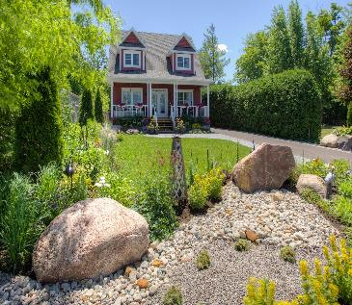
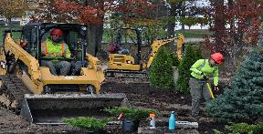
LANDSCAPE CONTRACTOR

Slide 10
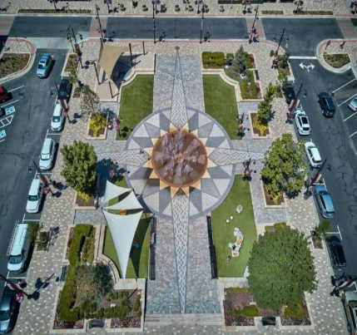
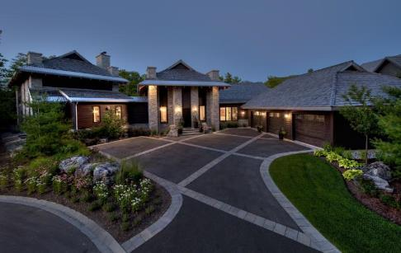
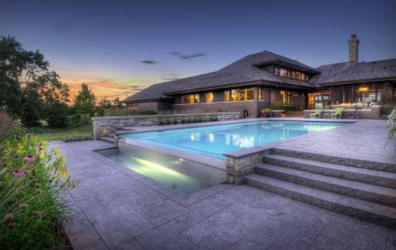
HARDSCAPE

Slide 11
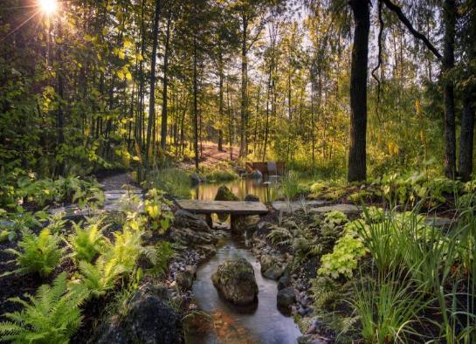
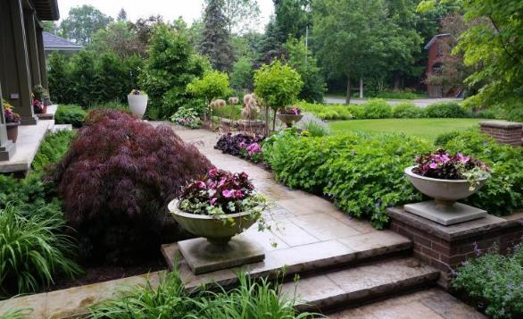
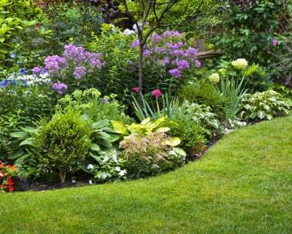
Softscape

Slide 12
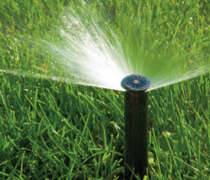
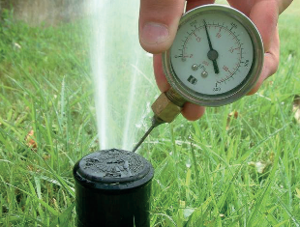
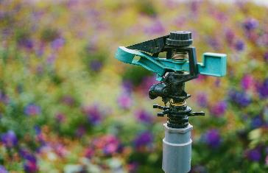
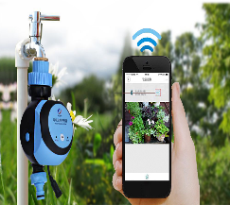
IRRIGATION

Slide 13
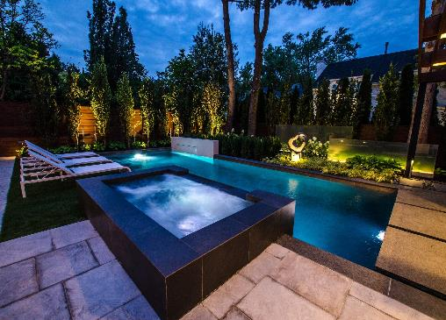
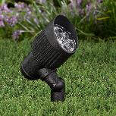
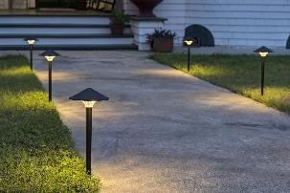
LIGHTING

Slide 14
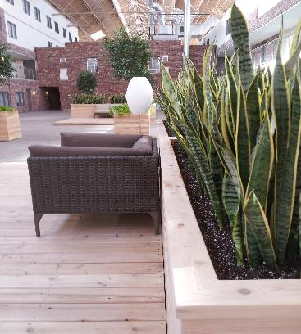
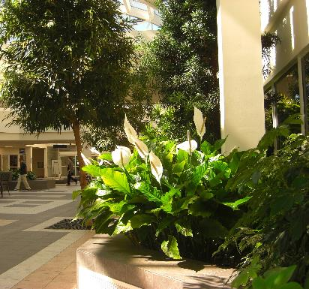
INTERIOR PLANTSCAPE

Slide 15
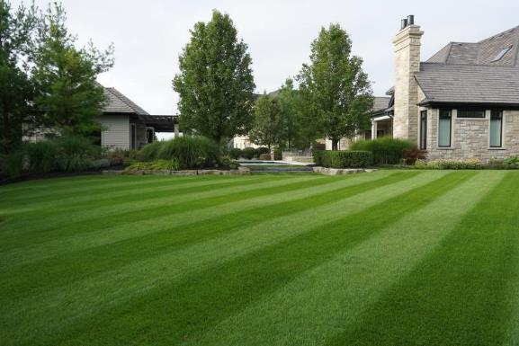
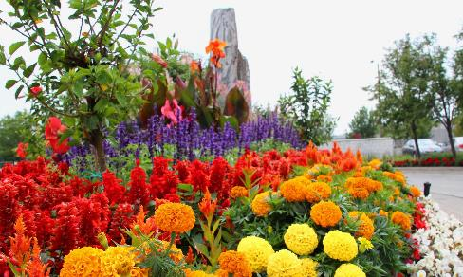
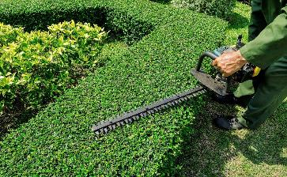
GROUNDS MANAGEMENT

Slide 16
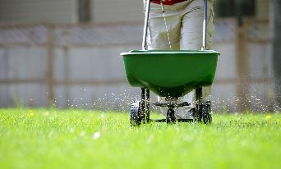
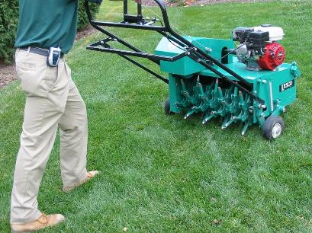
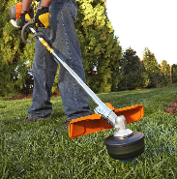
TURF MANAGEMENT

Slide 17
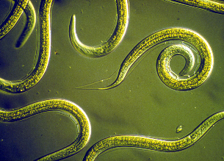
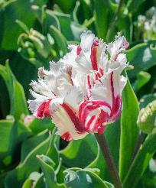
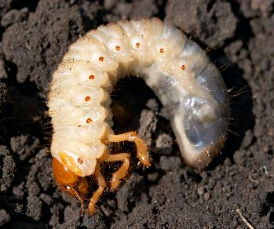
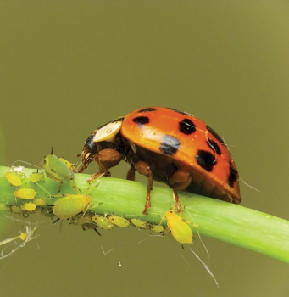
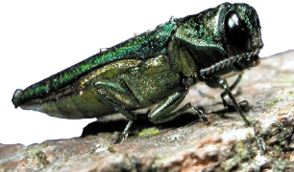
IPM

Slide 18
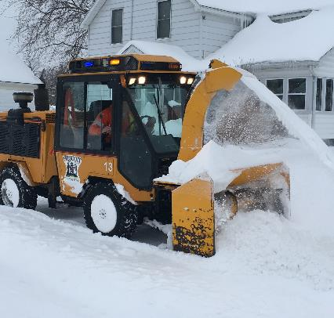
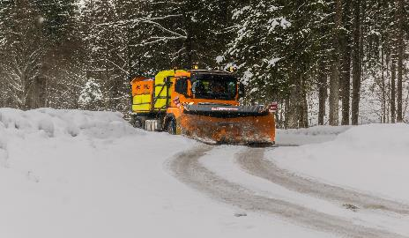
SNOW & ICE MANAGEMENT

Slide 19
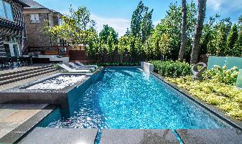
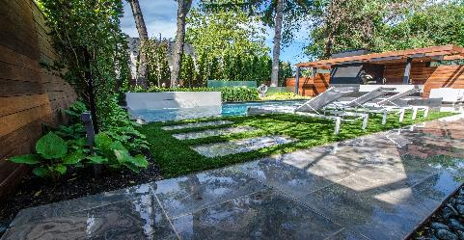
Award Winning Masterpieces by our Professionals
Notes:
Pro-Land Landscape Construction Modern Masterpiece
Awards of Excellence- Residential Landscape Construction
Context: Private property
Connection to Protecting and Enhancing Lives: backyard for residence to enjoy (by designing and building this space homeowners will likely get more use of their yard enjoying more time outside.
What are some things you notice in this picture?
Geared to clients wants
Green roof (helps increase the green footprint and utilizes water)
Seating area (various types of seating provided to meet clients needs)
Tall plantings (for privacy and creating a visually soft backdrop that will shade a portion of the property)
Lighting (for extended use of the space)

Slide 20
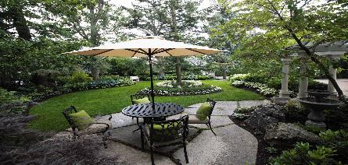
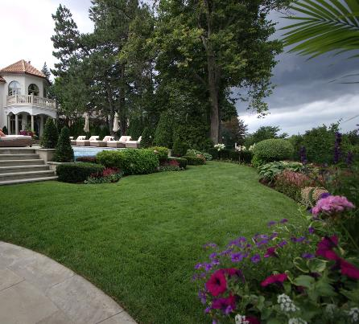
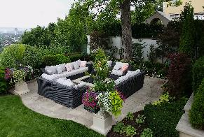
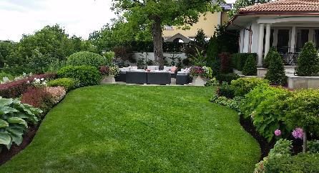
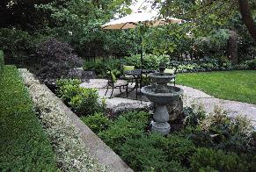
Award Winning Masterpieces by our Professionals
Notes:
Shades of Summer Landscaping & Maintenance- Balfour Residence
Awards of Excellence- Residential Landscape Maintenance
All of the professions we have talked about are or could be involved in creating a landscape such as this one!
“The property requires 20-25h a week of maintenance after an extensive spring cleanup. Fertilizing and fountains clean out is done regularly. All hedges on the property are sheared weekly except for the cedars, boxwoods
and yews which are done monthly.”

Slide 21
Career Opportunities Across the Sector Groups
Entry Crew Member
Horticultural Tech
Crew Leader/Foreman
Supervisor
Landscape Manager
Nursery Worker
Carpentry
Small Engine Tech
Turf Specialist
Irrigation & Plumbing
Landscape Designer
Hardscape & Masonry
Pool/Hot Tub Installer
Lighting & Electrical
Equipment Operator
Arborist
Snow & Ice
Garden Center Sales

Slide 22
The Perfect Storm; Start Your Journey
Employers are….
Turning away work due to labour shortage
Environment & Climate Change
Hiring between 1-10 employees per year
Looking for trained individuals
60,000+ Projected
Labour Shortage
Large Retiring Workforce
Providing Multi-Sector Career Opportunities

Slide 23
Skills & Attributes
Reading
Oral Communication
Writing
Digital Technology
Problem
Solving
Landscape Horticulture Technician
Numeracy
Team Player
Safety Conscious

Slide 24
Pathways Into the Profession
OYAP / SHSM / CO-OP
Pre-Employment Programs
PATHWAYS
Direct to Workforce
Apprenticeship Program
Lifelong Professional Career
College / University

Slide 25
Post-Secondary Opportunities

Slide 26
Horticultural Technician Apprenticeship Program
‘Earn While You Learn’
Training Standard Skills log book
*Completed on the job
5,400+/- On-the-job Hours
Two 12 week in-class sessions (winter months)
$4,000 in Grants; Government Subsidies Available

Slide 27
Professional Development
& Certification
Over 150 Seminars offered a year!

Slide 28
Why They Chose Post-Secondary Education
Destiny
Tobias
Nicole
Tristan
“To teach and improve people’s lives through horticulture and plants”
Niagara Parks School of Horticulture
“To improve food security in northern communities of Canada”
Fanshawe
College
“To help agriculture businesses become more sustainable”
University of
Guelph
“To support my career path while gaining on-the-job experience”
Apprentice
Mohawk College

Slide 29
Scholarships & Bursaries
Landscape Ontario gives out over $60,000 a year
Application deadline:
June 30th for the upcoming academic year
For More Information, Visit:
https://landscapeontario.com/scholarship-and-bursary

Slide 30
Build Your Future
Start Now!
Gain Experience...
ON GOING
Professional Development
NEXT STEPS
Micro Enterprises
Post Secondary Education
STARTING
OUT
Secondary School Courses
Summer Jobs
Build Your Network

Slide 31
Q & A
CLIMATE CHANGE
CAREERS
EDUCATION
GREEN INFRASTRUCTURE
OPPORTUNITIES
SECTOR SKILLS
Notes:
What did you learn about Landscaping & Horticulture?

Slide 32
For More Information
Sally Harvey
Director of Education & Workforce Development
sharvey@landscapeontario.com
Lissa Schoot Uiterkamp
Education & Youth Engagement Coordinator
lissa@landscapeontario.com
J Alex Gibson
Apprenticeship Program Coordinator
jagibson@landscapeontario.com
www.landscapeontario.com
www.horticulturetechnician.ca
www.greencareerscanada.ca

Slide 33
OPTIONAL ADDITIONAL SLIDES
FOR PRESENTERS
Notes:
* Replace with your contact information!

Slide 34
Jeopardy
Notes:
If you have internet connection you can click on the jeopardy board to play a game if you have left over time after your presentation.

Slide 35
A Word From Joe Landscape

