Slide 1
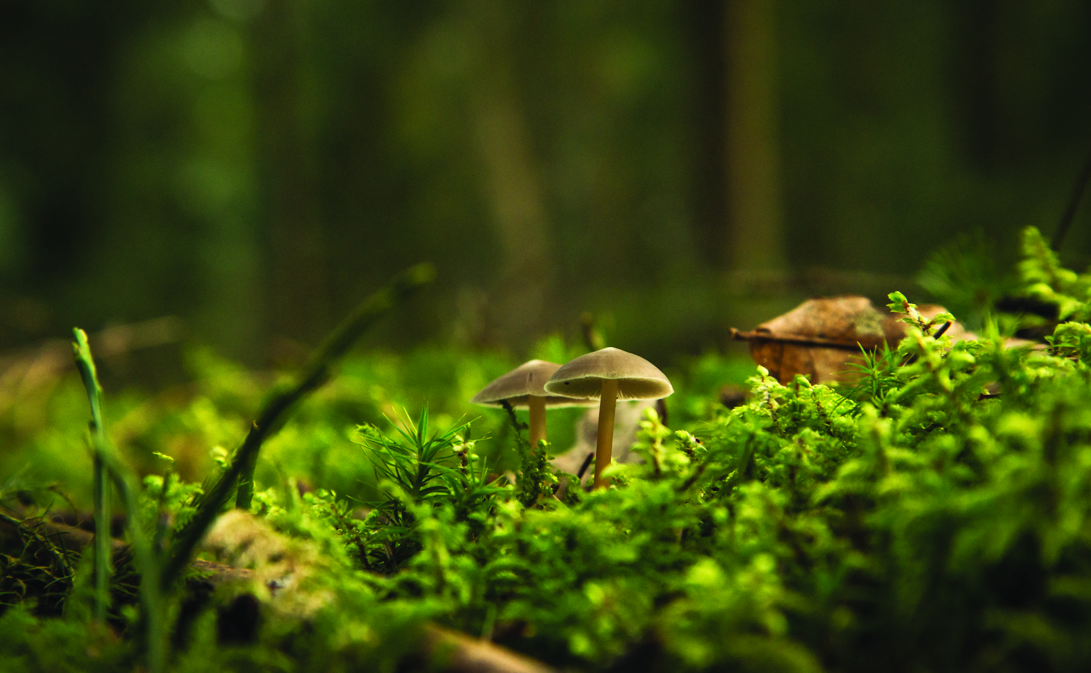

HOW TO MAKE SOIL TO SUPPORT THRIVING LANDSCAPES (compost)
Outcome
This STEM activity will provide the scientific and practical know how behind composting which is used to create and maintain sustainable outdoor spaces by supporting soil diversity and boosting plant health! In this workshop students will learn how to build their own starter composter using easy to find materials. Teach students what materials can go into a composter and how varying temperature, moisture and light conditions affect the composting process. Introduce students to careers in the Landscape Horticulture Profession that focus on plant health care and creating thriving and sustainable landscapes.
Preparation
Print activity worksheet or send digital copy to students
Customize powerpoint file
Gather materials or send materials list to students
Materials List
Activity Worksheet
One 5 gallon bucket & 2 lids (home depot, canadian tire or recycled container)
Drill or nail & hammer to make holes
Scissors
‘Green’ organic matter- food scraps, plant debris coffee grounds etc. (compost)
‘Brown’ organic matter- dried leaves, egg carton, shredded paper etc. (compost)
Water
Worms and soil (optional)

