Slide 1
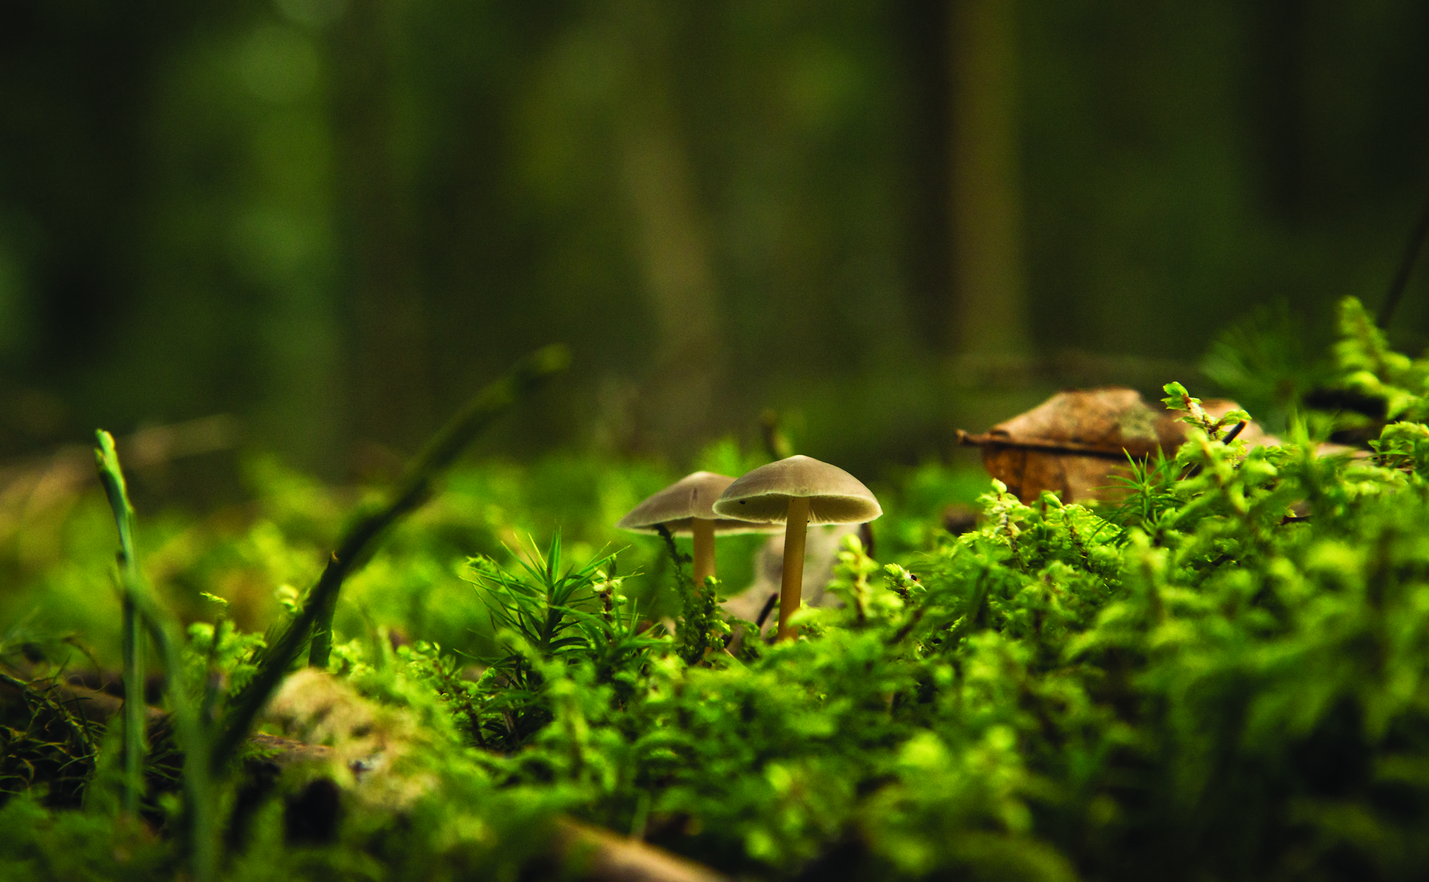
Welcome!
HOW TO MAKE SOIL TO SUPPORT THRIVING LANDSCAPES

Slide 2
Today’s Schedule
Introductions
2) Activity
3) Careers

Slide 3
Workshop Leaders
Feel free to ask us any questions throughout the workshop!
Name
Name

Slide 4
You!
https://www.wearebloom.org/
Notes:
2 min
https://www.wearebloom.org/

Slide 5
Notes:
2 min

Slide 6
Landscape Ontario
Protecting and Enhancing lives through
Designing, Building & Maintaining Green Infrastructure
Notes:
5min
Quality of life Health and Wellness
Physical
Improve air quality
Green spaces that remain cooler in summer months
Provide safe spaces for people of all ages to play games and sports to get active
Mental
Provide spaces for horticulture therapy
Strengthen a communities connection with nature (reduce the negative effects of nature deficit disorder)
Provide peaceful places that escape everyday life for contemplation and reflection
Building Strong Communities
Designing, building and maintaining aging park systems
Creating a network of corridors that connect people to public spaces
Protecting naturally significant areas
Environmental Stewardship
Native plantings to increase biodiversity
Municipalities that are mandated by their official plans to increase their canopy cover
Flood and erosion prevention and protection
Reduction in the urban heat island effect and creation or micro climates to provide more enjoyable places to enjoy the out doors

Slide 7
Activity!
BUILD YOUR OWN COMPOSTER!

Slide 8
Materials
Large Container (Think recycling!)
(pop bottle, bucket, flower pots, rubbermaid bins etc.)
2 trays/lids
(Plastic wrap, recycled tray, bucket lid, flower pot coaster etc.)
Hole making tool
(hammer and nail, drill etc.)
Scissors & Tape
Compostable material
(Green food scraps/ plant debris/ leaves etc.)
Worms & Soil (optional)

Slide 9
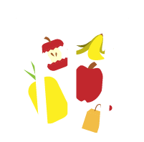
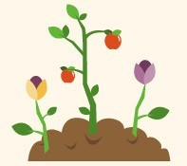
What is Compost
Once-living organisms will decompose into
compost.
Composting is a natural way to recycle
organic materials.
Composting organic waste will return nutrients
directly back to the soil to support the “circle of life”.
Adding compost to your garden will help your plants grow! Think of it as ‘Garden Gold’
https://www.sodgod.com/composting/

Slide 10
Benefits of Compost
Improves Plant Health
Reduces Landfill Waste & Greenhouse Gases
Reduces Water Use
Improves Soil Quality
Notes:
IMPROVES PLANT HEALTH
Compost supplies nutrients such as phosphorus and nitrogen to the soil which helps it grow.
Nitrogen (up)- Supports Leaf & stem growth, lack of it may lead to pale new leaves, yellow old leaves and slim fibrous stems
Phosphorus (down)- Supports Root & flower growth, lack of it may lead to underdeveloped root systems and flower drop
Potassium (all around)- Supports leaf and stem development overall
REDUCES LANDFILL WASTE & GREENHOUSE GASES
Compost helps divert materials from going to landfills which helps increase the lifespan of a landfill and reduces greenhouse gasses.
REDUCES WATER USE
Compost can hold up to 200% of its weight in water thus reducing the amount of water we add to our gardens
IMPROVES SOIL QUALITY
Compost increases the beneficial microbes like bacteria and fungi in the soil as well as improves soil structure

Slide 11
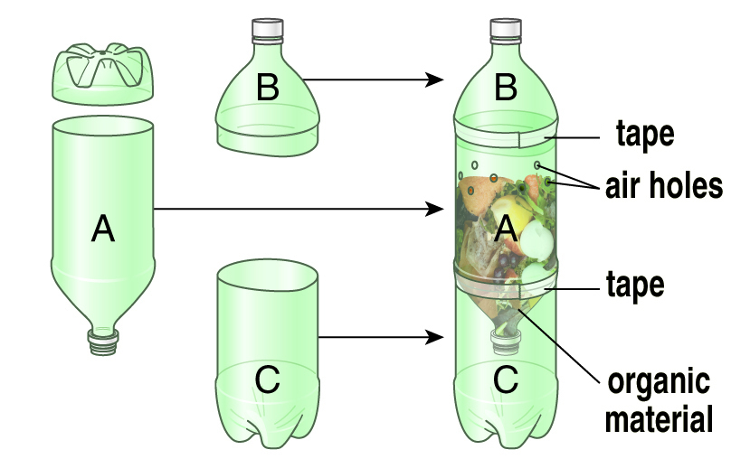
Notes:
Build the composter
Have a couple of options
Destiny build pop bottle one, Lissa build bucket one

Slide 12
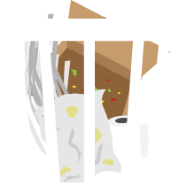
What to Compost?
Kitchen scraps
Yard waste
House waste
breads & grains
fresh leaves & weeds
dry leaves
fruits & veggies
grass clippings
egg cartons
egg shells
flowers & plants
paper towel
coffee & tea
dry leaves
shredded paper
https://www.sodgod.com/composting/
Notes:
Play short game by holding things up on the screen- have students make answer cards or thumbs up or down
https://www.abcya.com/games/recycling_game
green= Nitrogen brown = carbon

Slide 13
What NOT to Compost?
Some food
Some yard waste
Meat
Weeds with seeds
Dairy
Poison ivy
Grease fat or oil
Large branches
https://www.sodgod.com/composting/
Notes:
Play short game by holding things up on the screen- have students make answer cards or thumbs up or down
https://www.abcya.com/games/recycling_game
green= Nitrogen brown = carbon

Slide 14
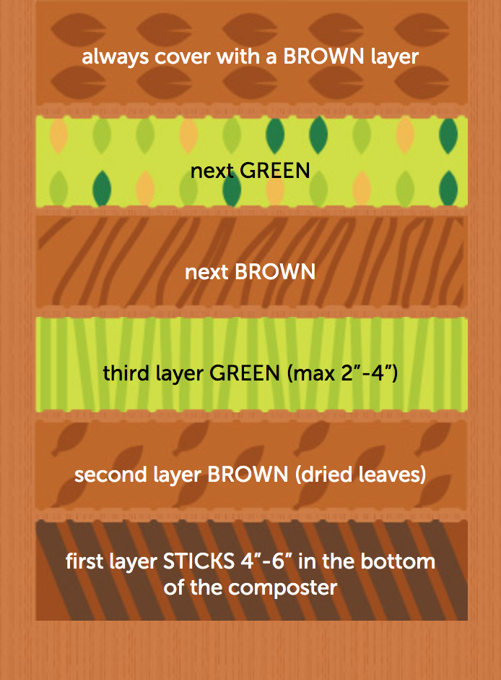
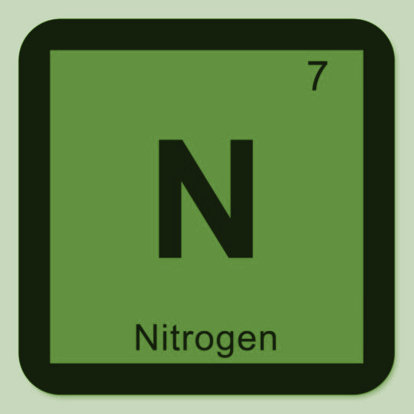
Layering
One (1) part ”GREEN”
Two (2) parts ”BROWN”
GREEN materials contain more NITROGEN: vegetable or fruit kitchen waste, grass clippings etc.
BROWN materials contain more CARBON: dead leaves or flowers, straw, shredded newspaper etc.
Notes:
Green/ Nitrogen
Supports microbes protein growth
Speeds up decomposition
Too much Nitrogen may cause smells
Brown/ Carbon
Feeds microbes
Absorbs excess water
Too much Carbon may slow decomposition

Slide 15
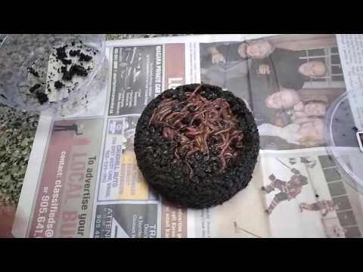
Optional: Add Worms!
Composting with worms is called vermiculture
Worms eat their body weight in organic material and produce castings (worm poop) that is broken down organic materials high in nutrients
Red wigglers are highly suited to container composting
Notes:
Red wigglers are highly suited to container composting
Tolerate high heat
Eat food on surface
Reproduce faster than earth worms

Slide 16
Taking Care of Your Compost Pile!
KEEP MOIST: As wet as a wrung out sponge
AERATE: Air helps to speed up decomposition, mix regularly.
KEEP COVERED: Use a lid or other material to keep moisture in
‘Garden Gold’
https://www.sodgod.com/composting/
Notes:
Have a couple of options
Destiny build pop bottle one, Lissa build bucket one

Slide 17
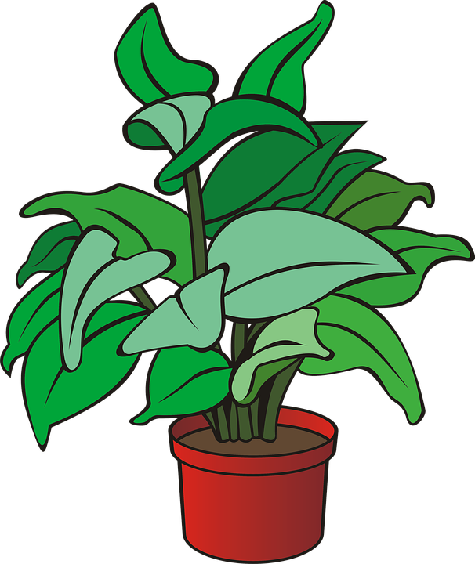
Experiment!
NO Compost
Compost Added

Slide 18
Careers!

Slide 19
CAREERS
Notes:
2

Slide 20
CAREERS!
Notes:
2

Slide 21
PATHWAYS INTO THE PROFESSION!
Interested & have questions?
VISIT
CONTACT US!
Lissa@landscapeontario.com
Sally@landscapeontario.com
Cassandra@landscapeontario.com
OYAP/ SHSM / CO-OP/ Dual Credit
PATHWAYS
Direct to Workforce
Apprenticeship Program
College / University
Notes:
2

Slide 22
Any Questions?
CLIMATE CHANGE
CAREERS
EDUCATION
GREEN INFRASTRUCTURE
OPPORTUNITIES
SECTOR SKILLS

Slide 23
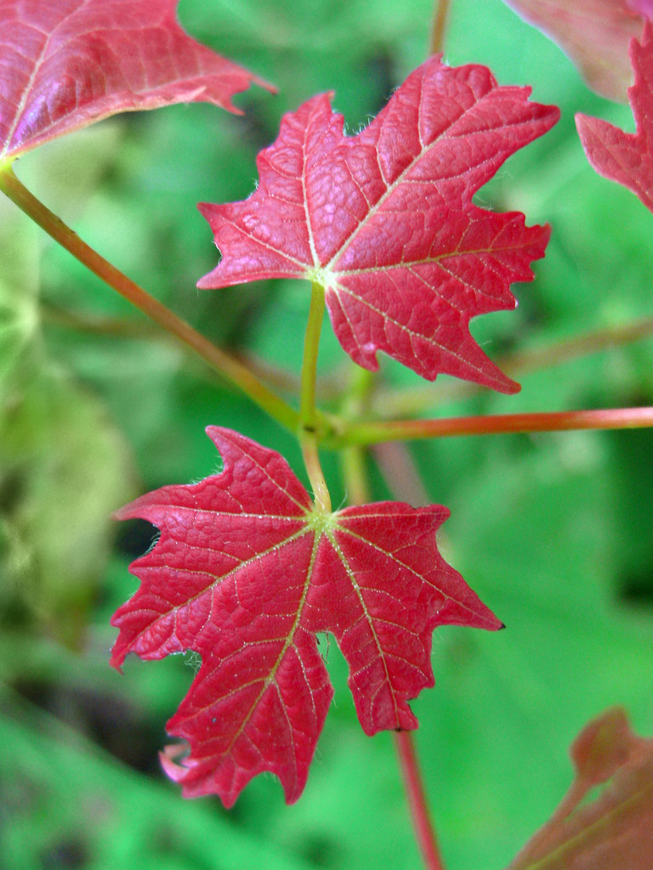
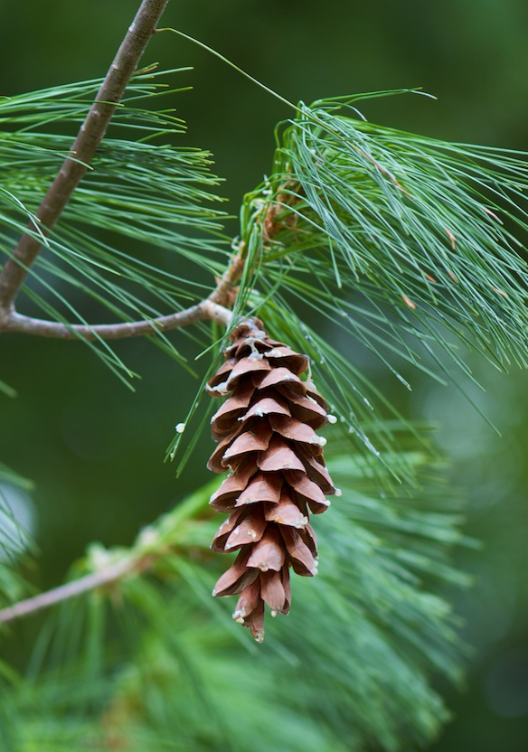
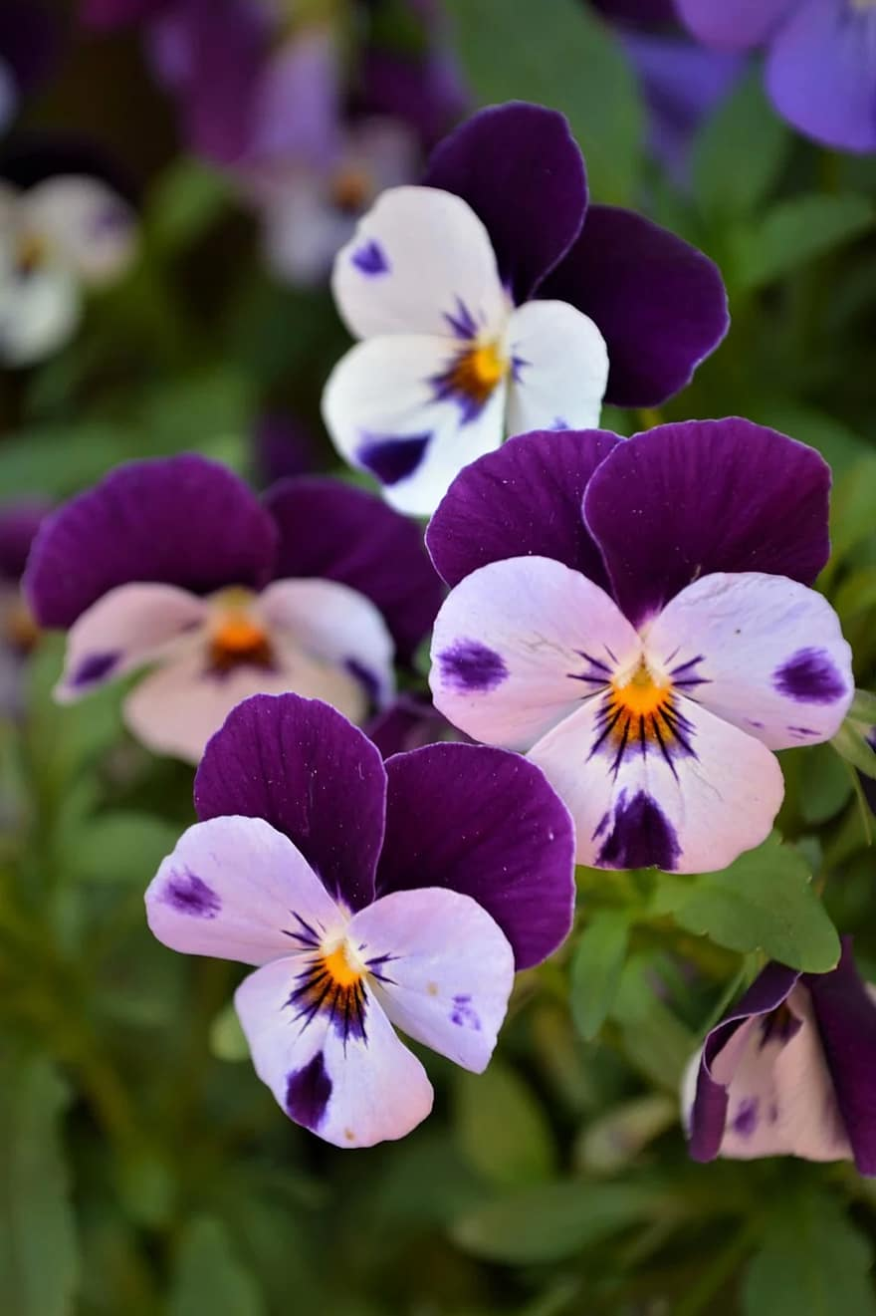
Guess That Plant
Use the sheet attached to your activity package and the clues provided to discover each plant
Sugar Maple
Witch-hazel
White Pine
Pansy
Dogwood
Sugar maple
HINT: It’s a pretty sweet plant
HINT: It’s a great Halloween costume
HINT: A character with 7 Dwarves
HINT:This plant is not cowardly
HINT: It’s got a pretty loud bark
Witch hazel
White pine
Pansy
Dogwood
acer saccharum
hamamelis sp.
pinus stobus
viola tricolor
cornus sericea

