Slide 1
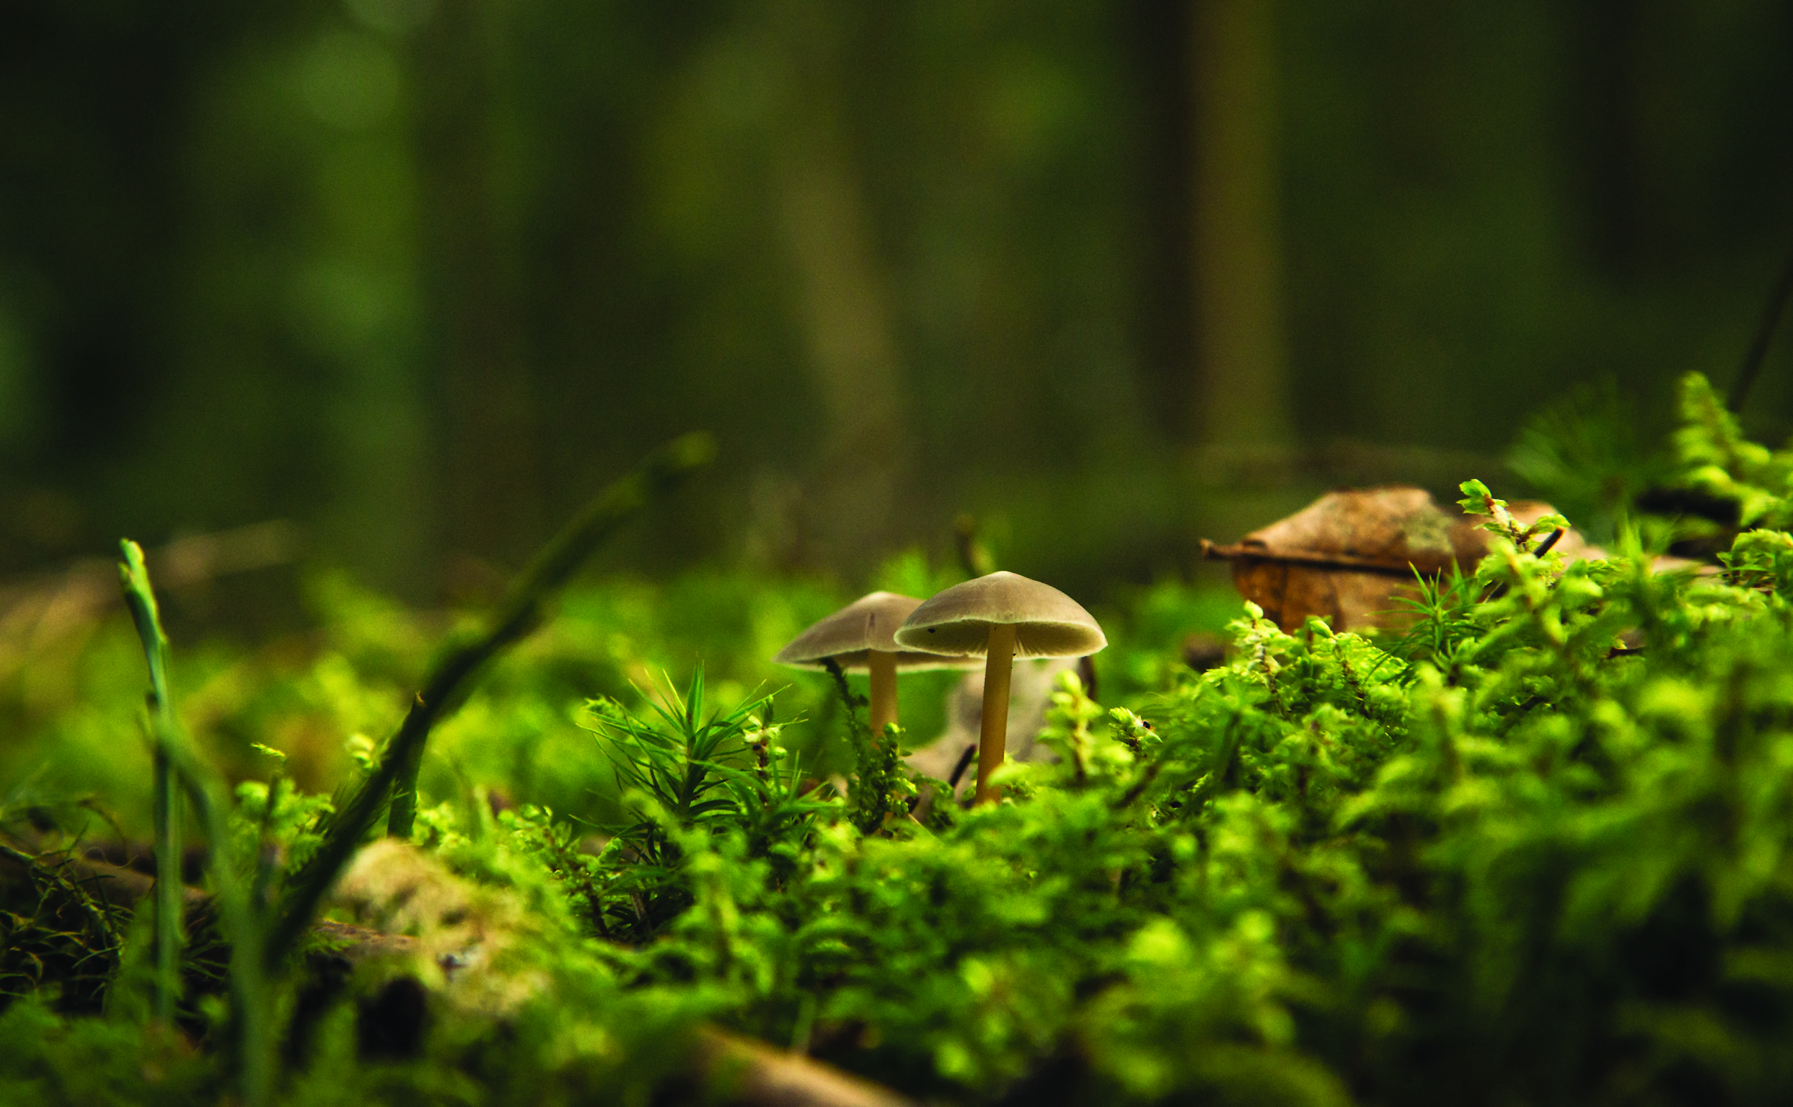

HORTICULTURE THERAPY & PROPAGATION
Outcome
This horticulture therapy workshop teaches students how plants can benefit people. Introduce students to career and education pathways in horticulture therapy and lead students through horticulture therapy activities that that will teach them:
How to correctly propagate using seeds and cuttings
How to maintain plant health while watching your plant grow
How to reap the positive benefits of horticulture therapy in day to day activities
Preparation
Print activity worksheet or send digital copy to students
Customize powerpoint file
Gather materials or send materials list to students
Materials List
Activity Worksheet
Potato, onion or garlic bulbs
Seeds of your choosing
Flower pot (or recycled egg cartons, toilet paper rolls etc)
Potting soil
Pencil & paper/ notebook

