Slide 1
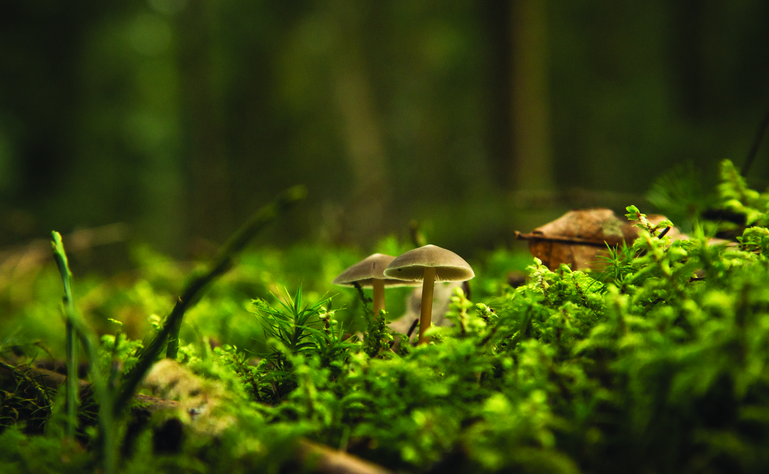
Welcome!
HORTICULTURE THERAPY & PROPAGATION

Slide 2
Today’s Schedule
Introductions
2) Activity
3) Careers

Slide 3
Workshop Leaders
Feel free to ask us any questions throughout the workshop!
Name
Name

Slide 4
Landscape Ontario
Protecting and Enhancing lives through
Designing, Building & Maintaining Green Infrastructure
Notes:
5min
Quality of life Health and Wellness
Physical
Improve air quality
Green spaces that remain cooler in summer months
Provide safe spaces for people of all ages to play games and sports to get active
Mental
Provide spaces for horticulture therapy
Strengthen a communities connection with nature (reduce the negative effects of nature deficit disorder)
Provide peaceful places that escape everyday life for contemplation and reflection
Building Strong Communities
Designing, building and maintaining aging park systems
Creating a network of corridors that connect people to public spaces
Protecting naturally significant areas
Environmental Stewardship
Native plantings to increase biodiversity
Municipalities that are mandated by their official plans to increase their canopy cover
Flood and erosion prevention and protection
Reduction in the urban heat island effect and creation or micro climates to provide more enjoyable places to enjoy the out doors

Slide 5
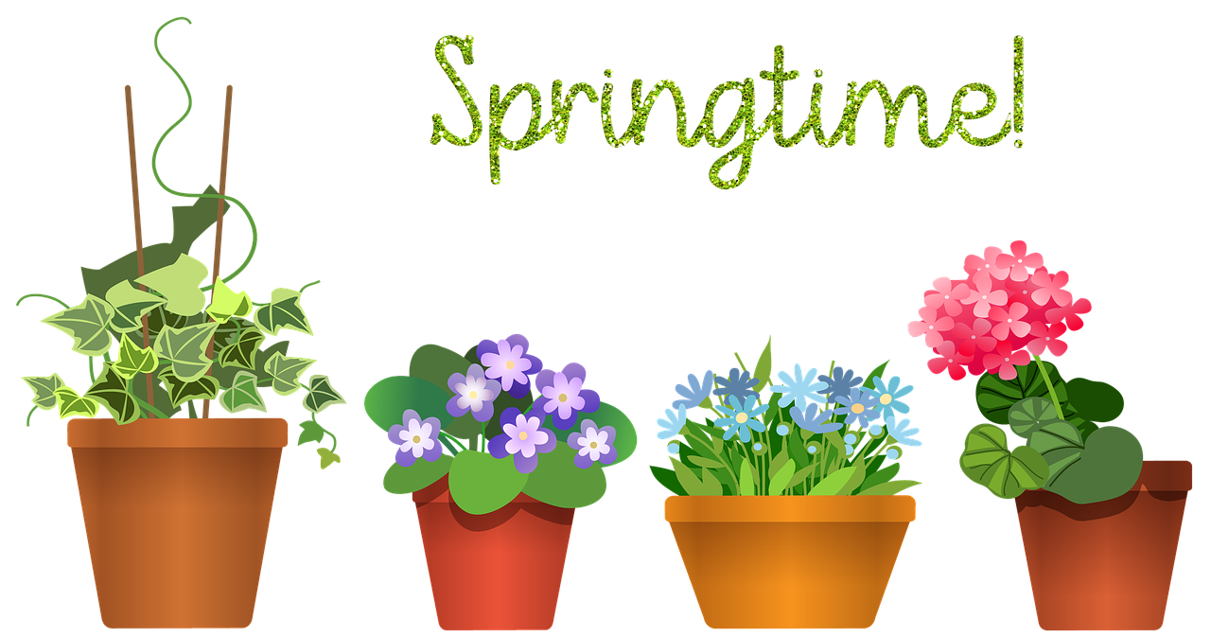
You!
What is your favourite plant!
Or
What plant are you currently growing!

Slide 6
What is Horticulture Therapy?
Horticultural therapy is defined by the American Horticultural Therapy Association as the engagement of a person in gardening and plant-based activities, facilitated by a trained therapist.
American Horticultural Therapy Association
Notes:
** maybe change slide to promo video

Slide 7
Examples of Horticulture Therapy
Notes:
** maybe change slide to promo video

Slide 8
Horticulture Therapy has Many Benefits!
Notes:
** maybe change slide to promo video

Slide 9
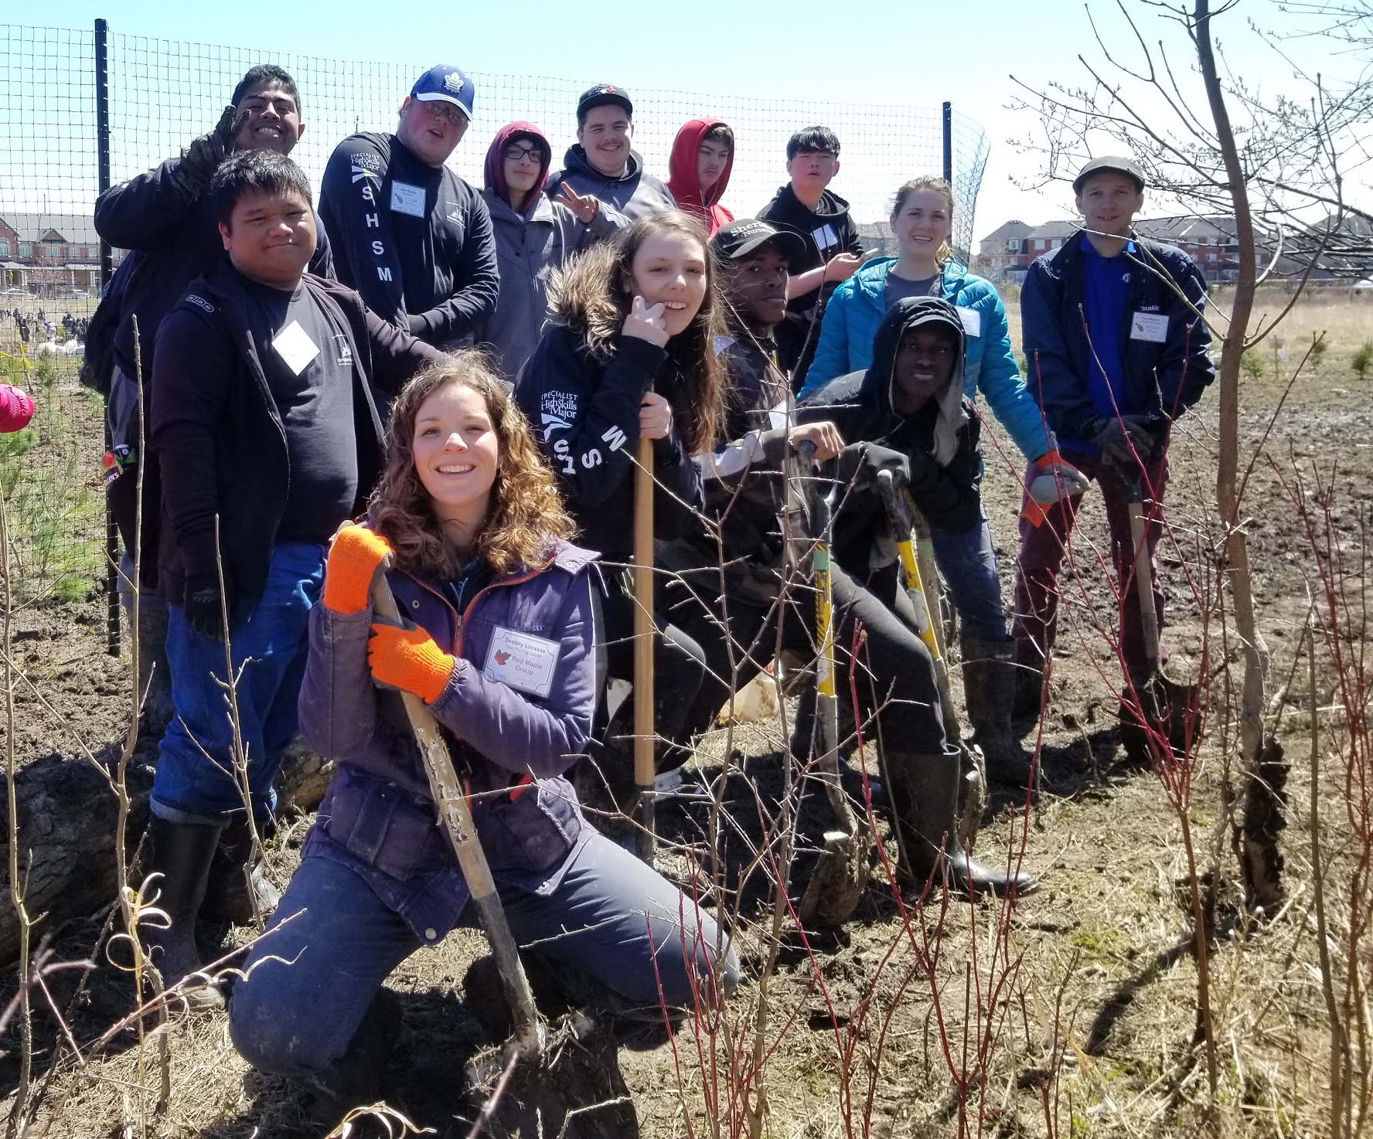
My Job
To make sure all projects are successful.
To know clients needs, and to help them overcome their struggles.
To better the life of the clients!
Notes:
** maybe change slide to promo video

Slide 10
Activity!
Grow-Care-Share!

Slide 11
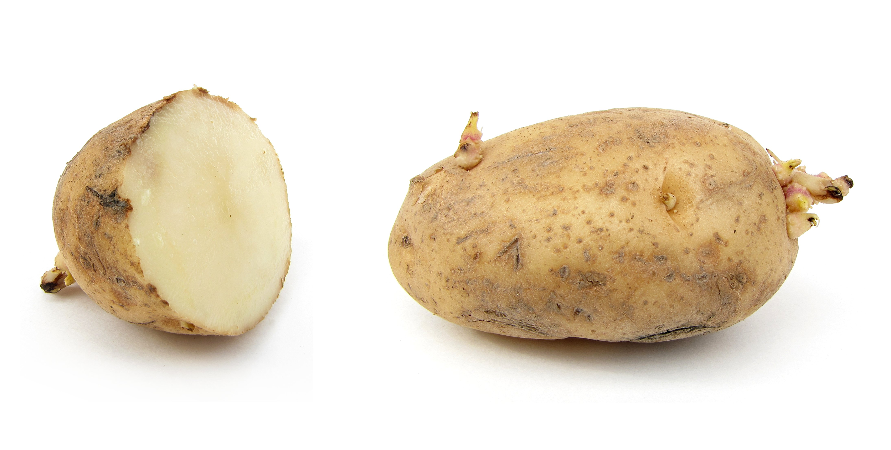
Step 1: Gather Materials
Notes:
** maybe change slide to promo video

Slide 12
Step 2: Plant Your Seed/ Vegetable
2x
+
Notes:
** maybe change slide to promo video
Garlic https://www.youtube.com/watch?v=qpCu2h3VV1s
Potato https://www.youtube.com/watch?v=2637Ga0YUgM

Slide 13
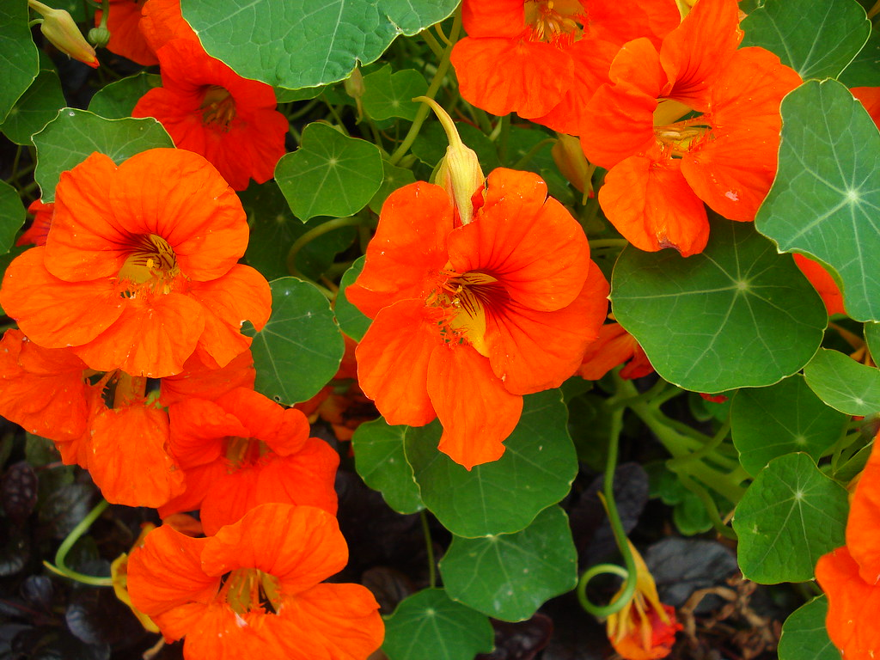
Step 3: Care For Your Seedling
+
+
=

Slide 14
Caring for our seedlings:
Nasturtiums- Thrive in poor to average, slightly acidic, well-drained soil. Grown in full sun, you might consider using some rocks around the plants to prevent their roots from getting too hot. In partial shade, plants tend to have larger leaves and a more sprawling habit.
Potato- Always do best in full sun. They are aggressively rooting plants, and we find that they will produce the best crop when planted in a light, loose, well-drained soil.
Garlic- Timing: Plant cloves from September to the end of November. ...
Sowing: Separate the cloves and set each one, pointed end up, 10-15cm (4-6”) apart and with the tip of the clove 2-5cm (1-2”) deep. ...
Soil: Rich, well drained soil. ...
Onion- Soil: Plant in full sun in well-drained soil. Apply compost three weeks prior to sowing or transplanting. Dig plenty of finished compost into the onion bed.

Slide 15
Step 4: Challenge!
Notes:
** maybe change slide to promo video

Slide 16
Careers!

Slide 17
CAREERS!
Notes:
2

Slide 18
PATHWAYS INTO THE PROFESSION!
Interested & have questions?
VISIT
CONTACT US!
Lissa@landscapeontario.com
Sally@landscapeontario.com
Cassandra@landscapeontario.com
OYAP/ SHSM / CO-OP/ Dual Credit
PATHWAYS
Direct to Workforce
Apprenticeship Program
College / University
Notes:
2

Slide 19
Any Questions?
CLIMATE CHANGE
CAREERS
EDUCATION
GREEN INFRASTRUCTURE
OPPORTUNITIES
SECTOR SKILLS

Slide 20
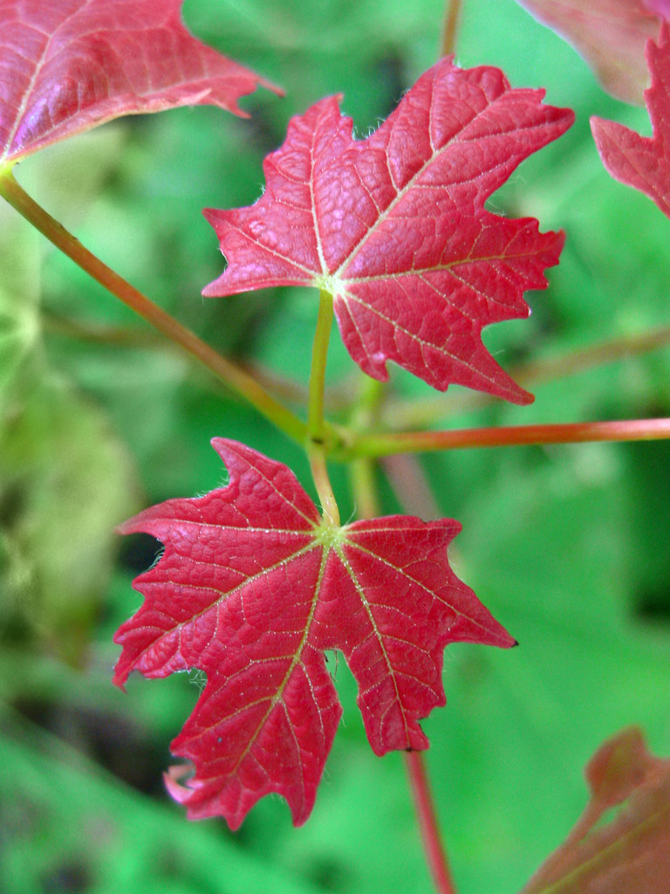
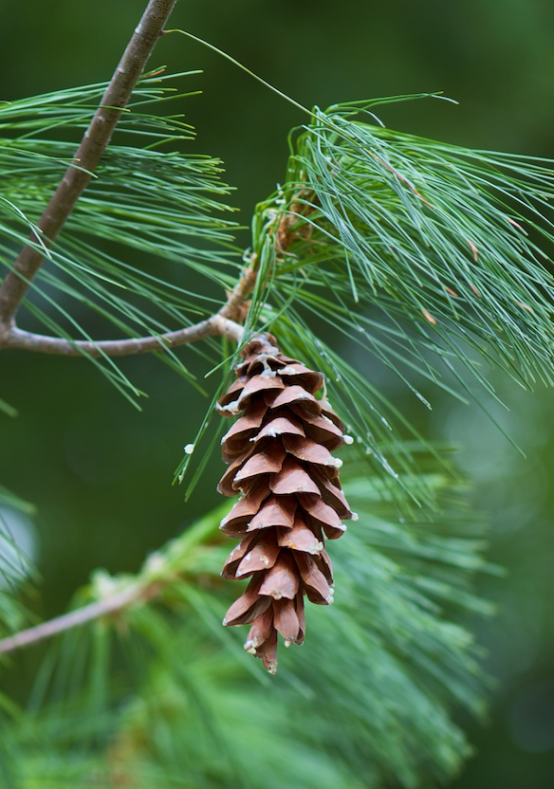
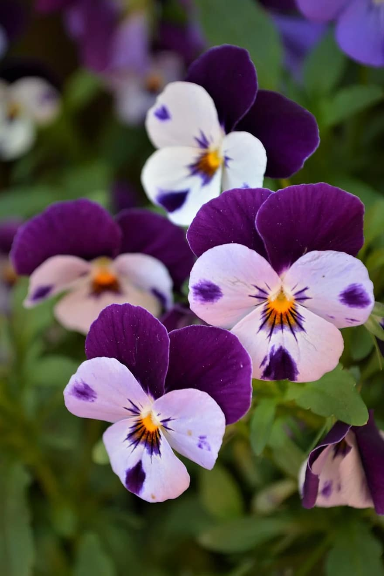
Guess That Plant
Use the sheet attached to your activity package and the clues provided to discover each plant
Sugar Maple
Witch-hazel
White Pine
Pansy
Dogwood
Sugar maple
HINT: It’s a pretty sweet plant
HINT: It’s a great Halloween costume
HINT: A character with 7 Dwarves
HINT:This plant is not cowardly
HINT: It’s got a pretty loud bark
Witch hazel
White pine
Pansy
Dogwood
acer saccharum
hamamelis sp.
pinus stobus
viola tricolor
cornus sericea

