Slide 1
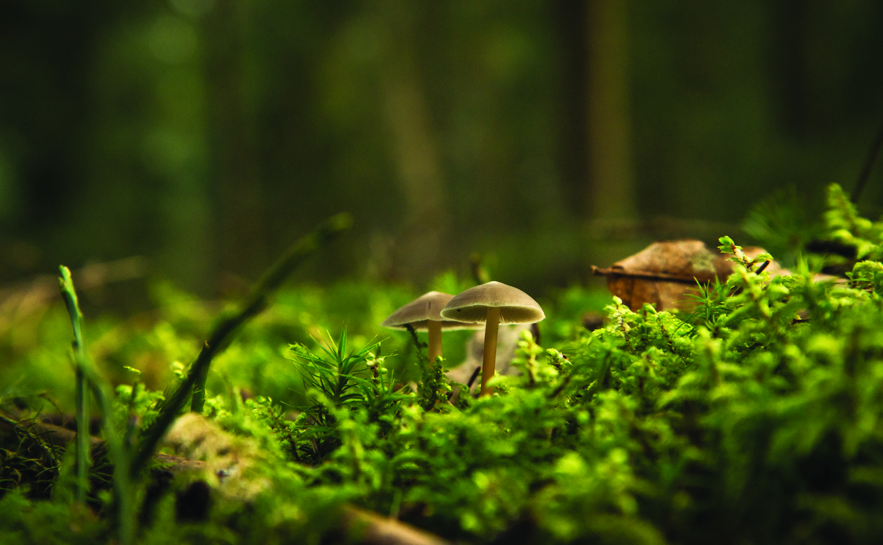

DESIGN YOUR DREAM GARDEN
Outcome
Teach students how to design a garden of their dreams! In this activity students will use the design process to design a landscape that is aesthetically pleasing, environmentally sustainable and meets the needs of the site user(s). Teach students how site conditions such as sun exposure and water runoff affect landscape design and plant placement. Have students explore creative solutions and inspirational ideas to influence influence their design. Students will learn about the elements and principles of design to create a beautiful and environmentally friendly design!
Preparation
Print activity worksheet or send digital copy to students
Customize powerpoint file
Gather materials or send materials list to students
Materials List
Activity Worksheet
Parchment paper
Pencil
Black marker
Coloured markers or pencil crayons
Optional: base map of your yard (a template will be provided however you can choose to create your own)

