Slide 1
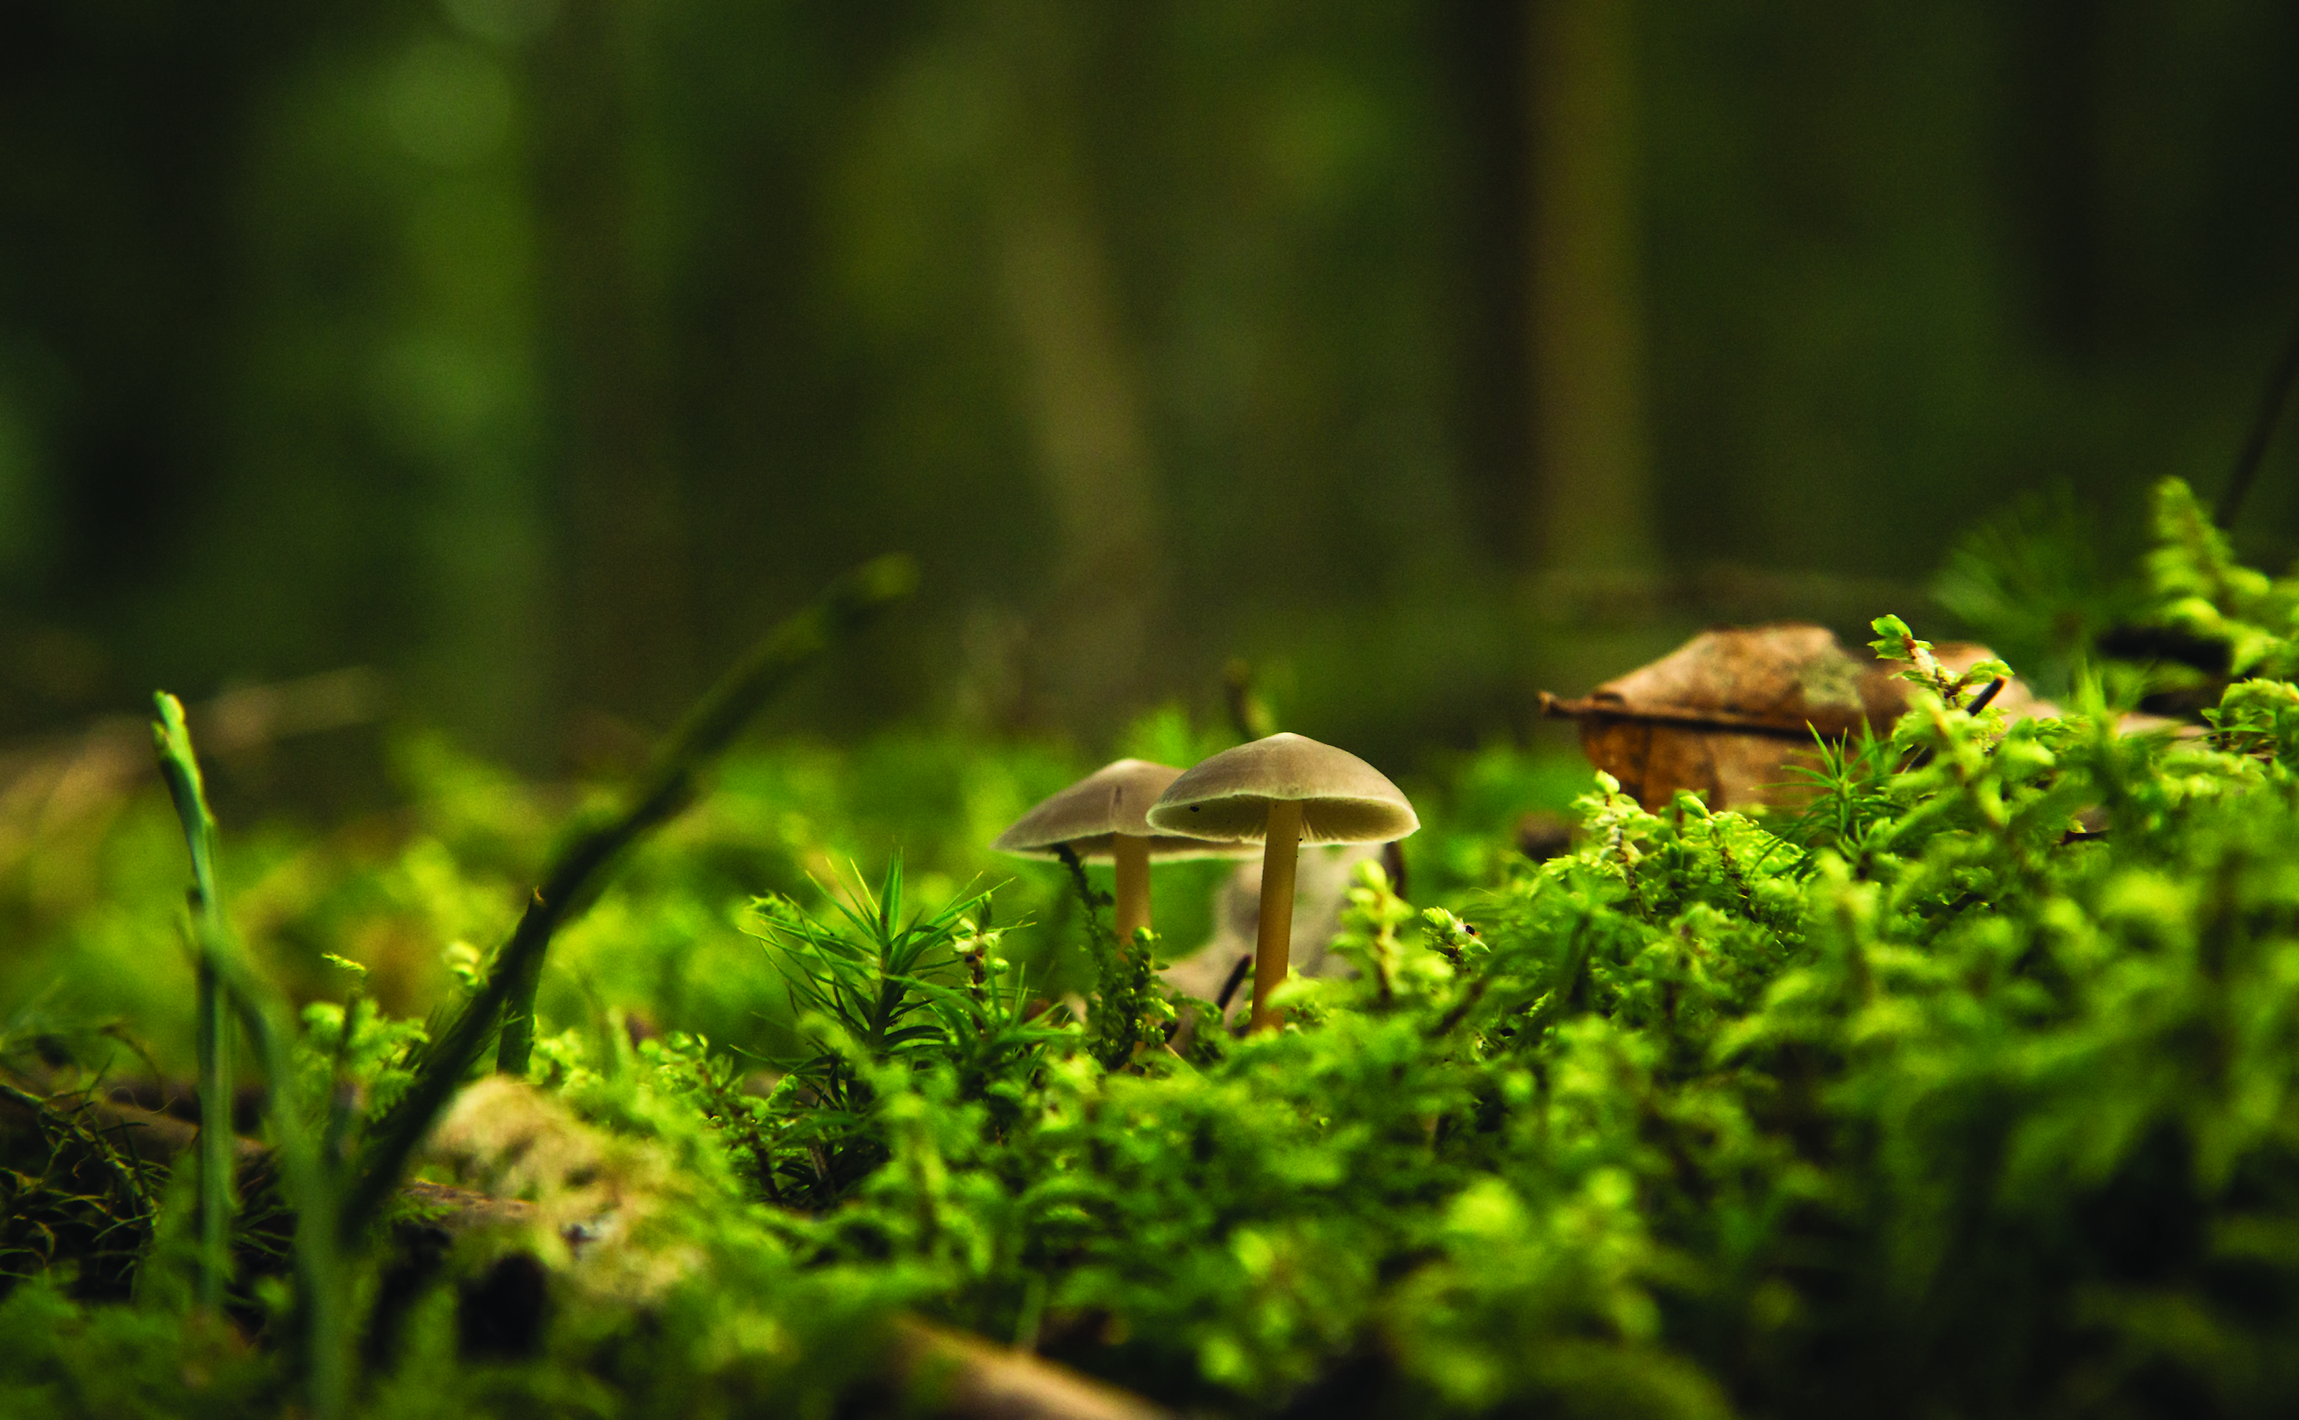
Welcome!
DESIGN YOUR DREAM GARDEN

Slide 2
Today’s Schedule
Introductions
2) Activity
3) Careers

Slide 3
Workshop Leaders
Feel free to ask us any questions throughout the workshop!
Name
Name

Slide 4
Intro: Landscape Ontario
Protecting and Enhancing lives through
Designing, Building & Maintaining Green Infrastructure
Notes:
5min
Quality of life Health and Wellness
Physical
Improve air quality
Green spaces that remain cooler in summer months
Provide safe spaces for people of all ages to play games and sports to get active
Mental
Provide spaces for horticulture therapy
Strengthen a communities connection with nature (reduce the negative effects of nature deficit disorder)
Provide peaceful places that escape everyday life for contemplation and reflection
Building Strong Communities
Designing, building and maintaining aging park systems
Creating a network of corridors that connect people to public spaces
Protecting naturally significant areas
Environmental Stewardship
Native plantings to increase biodiversity
Municipalities that are mandated by their official plans to increase their canopy cover
Flood and erosion prevention and protection
Reduction in the urban heat island effect and creation or micro climates to provide more enjoyable places to enjoy the out doors

Slide 5
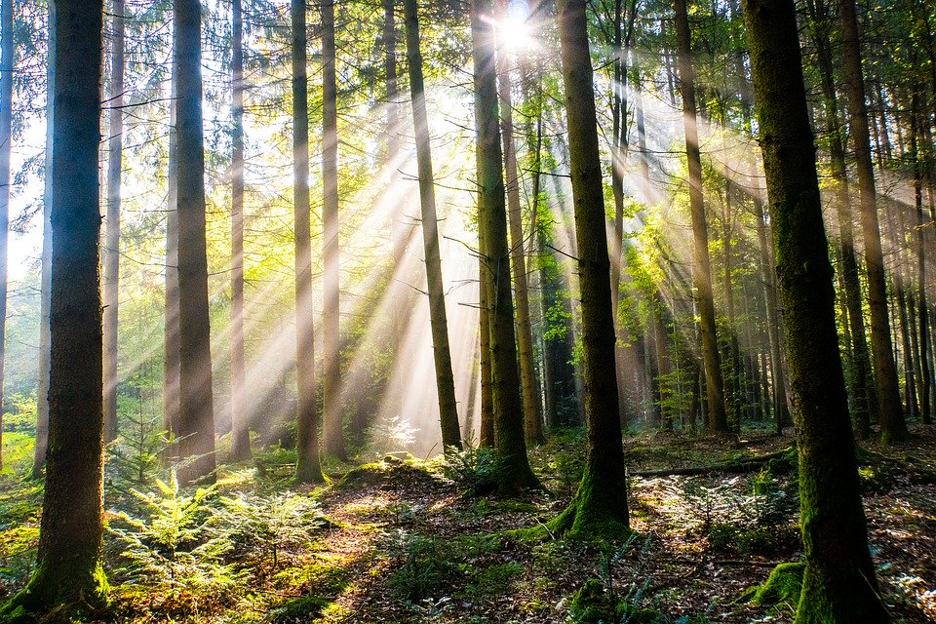
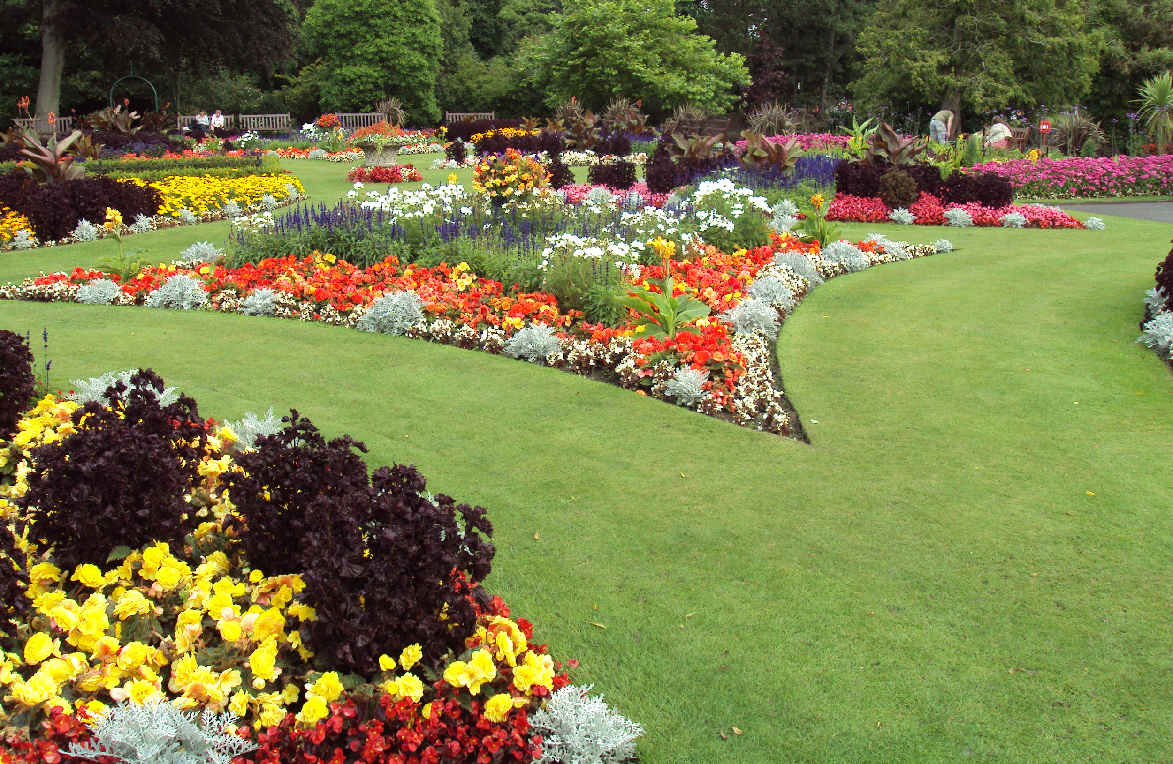
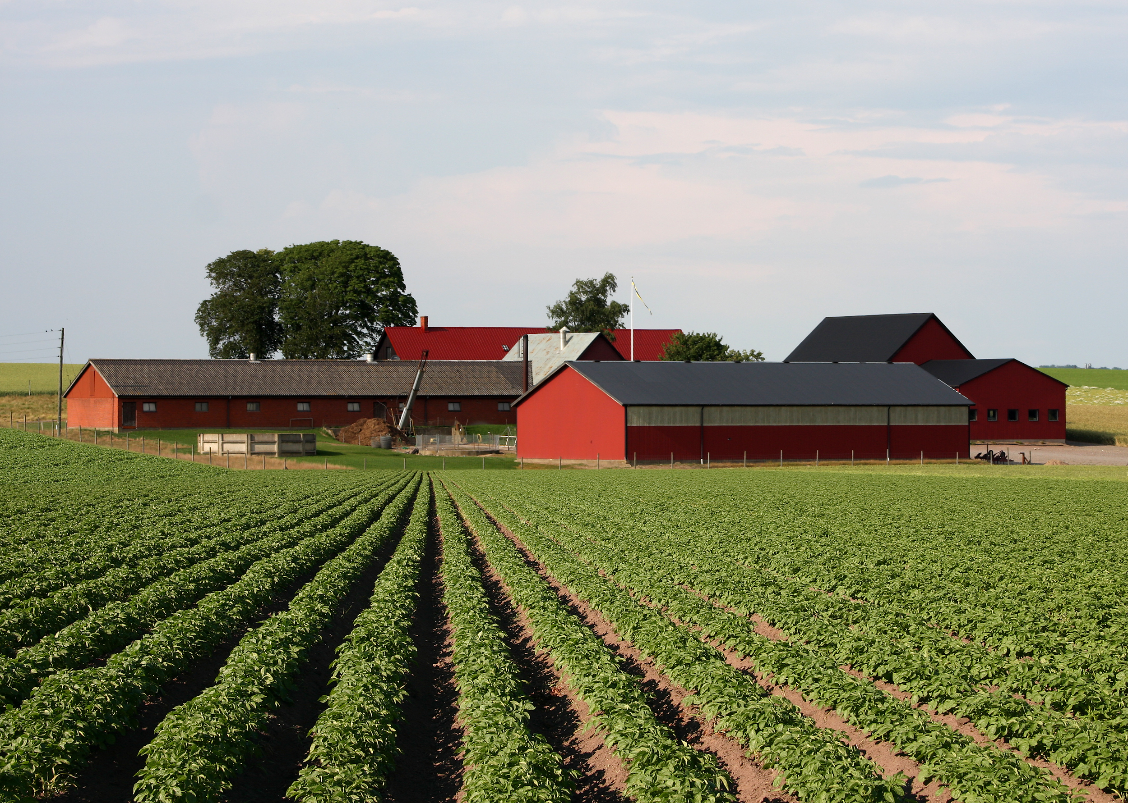
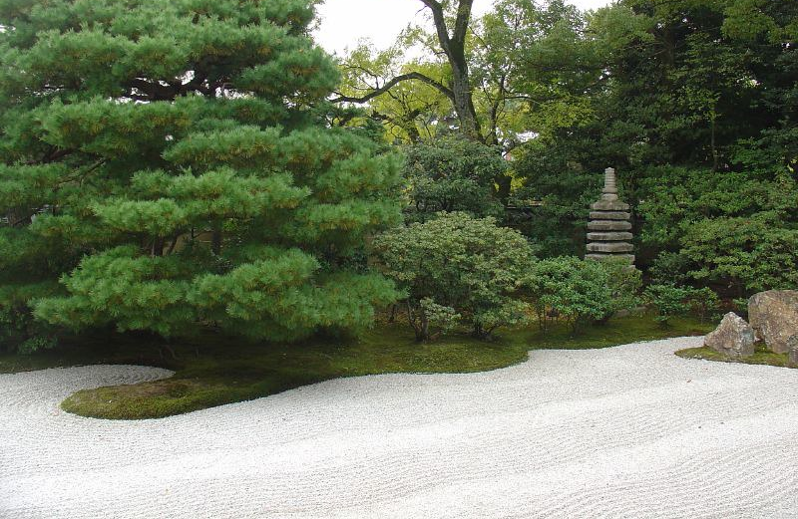
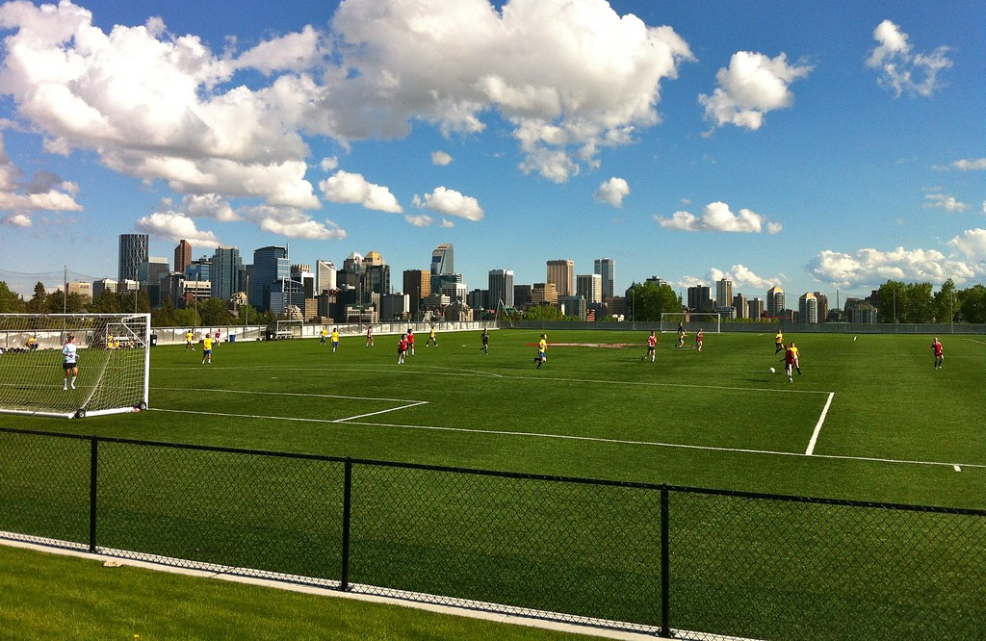
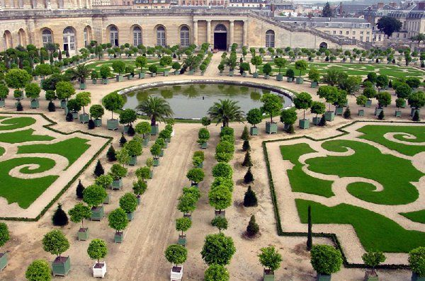
Choose your favourite Landscape… WHY! :)
1
2
3
4
5
6

Slide 6
Activity!
DESIGN YOUR DREAM GARDEN

Slide 7
Materials

Slide 8
Step 1: Pick a Site to Design
My future garden
Option 1: Provided Base Plan (backyard)
Option 2: A site of your choosing!
(you will need to draw a simple base plan)

Slide 9
Step 2 Site Considerations
List some considerations when it comes to designing this site
What abiotic (non living) and biotic (living) factors might influence your design?

Slide 10
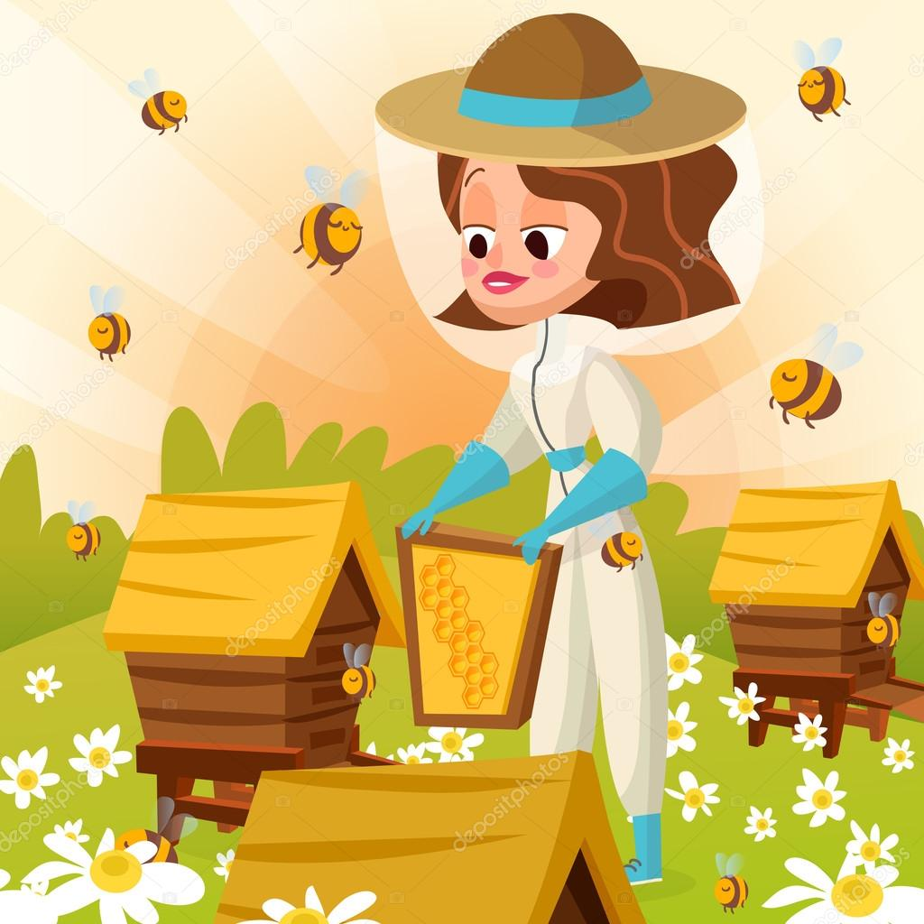
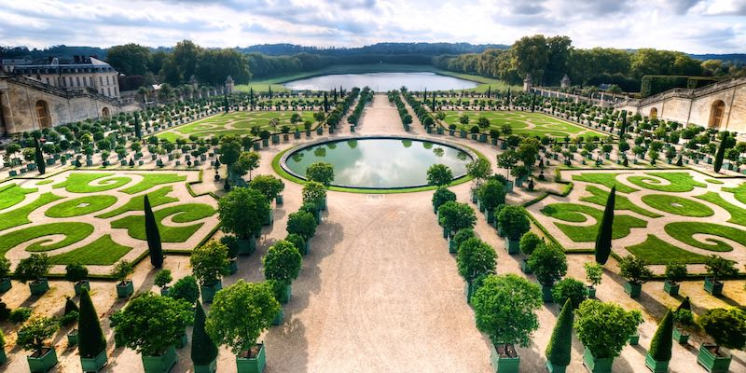
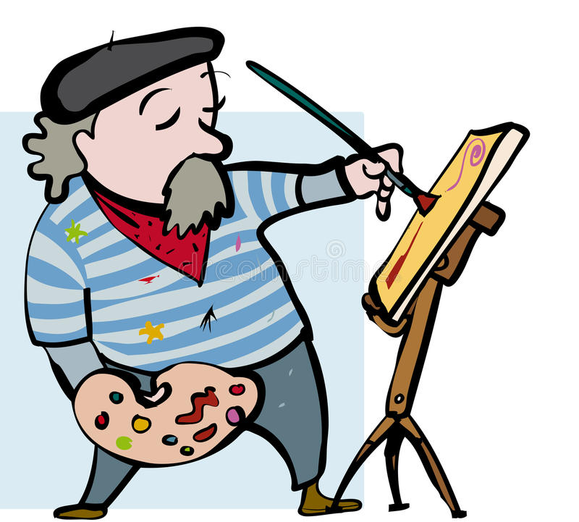
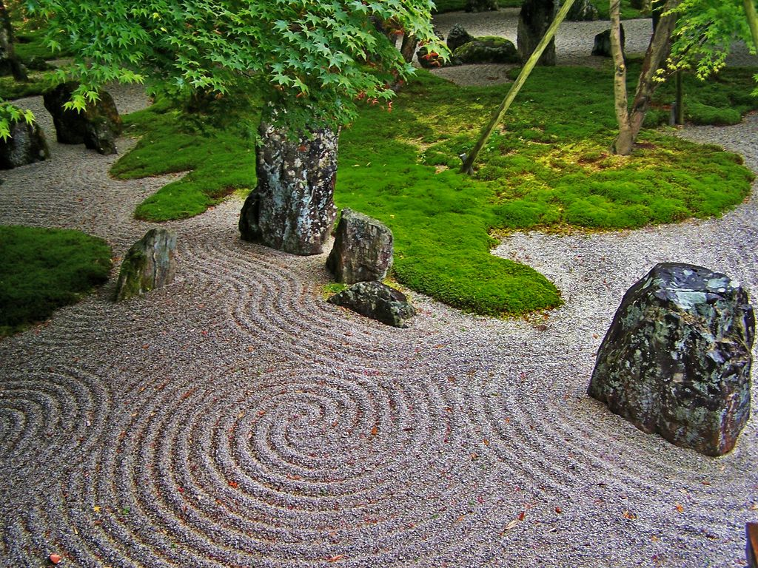
Step: 3 Client Wish List
Choose your Client
#1 #2 #3 #4 #5 #6
Create a wish list based on thats clients interests

Slide 11
Client #1
The Chef
Likes to cook
Favourite food is tomatoes
Enjoys spending time in the garden

Slide 12
Client #2
Bee Keeper
Looking for a garden to help his bees make more honey
Likes native plants and flowers
Wants a bee hotel or a bird feeder in the garden

Slide 13
Client #3
The Prince
Versailles gardens is their all time favourite garden
They like things to be symmetrical
They like clean crisp lines with a balance between plant material and stone

Slide 14
Client #4
The Artist
Loves to paint
Has a house full of bright bold colours and loves it
Wants to be able to paint his garden at all time of the year

Slide 15
Client #5
The Zen Master
Visited a rock garden in Japan and loved it!
Wants to conserve water (Xeriscaping)
Prefers a minimalistic landscape that is low maintenance

Slide 16
Client #6
You!
Think of your favourite spaces
Create a list of what you would like in your yard

Slide 17
Client #1: The Chef
Client #4: The Artist
Client #2: The Beekeeper
Client #5: The Zen Master
CHOOSE YOUR CLIENT
Client #3: The Prince
Client #6: You
Likes to cook
Favourite food is tomatoes
Enjoys spending time in the garden
Loves to paint
House full of bright bold colours and loves it
Wants to be able to paint his garden at all time of the year
Looking for a garden to help his bees make more honey
Likes native plants and flowers
Wants a bee hotel or a bird feeder in the garden
Loves rock gardens
Wants to conserve water (Xeriscaping)
Prefers a minimalistic landscape that is low maintenance
Versailles gardens is their favourite garden
Symmetrical
They like clean crisp lines with a balance between plant material and stone
Think of your favourite spaces
Create a list of what you would like in your yard

Slide 18
Step 4: Design Time!
The Edible Landscape!
Client #1: The Chef
Lissa Schoot Uiterkamp
July 23

Slide 19
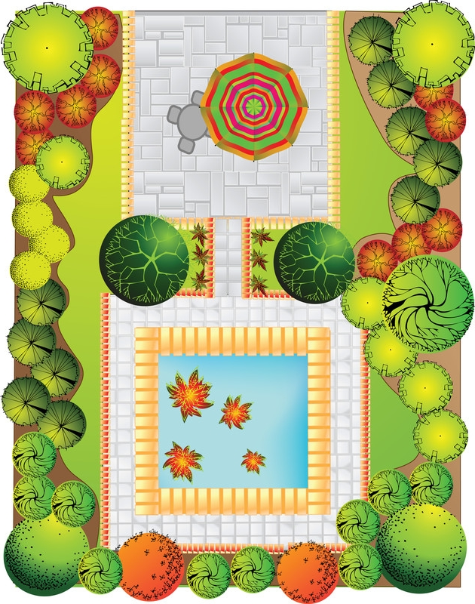
Design Principles
Repetition->
Variety ->
Balance ->
Emphasis->
Scale ->
Sequence->
Notes:
Easy to use pieces of advice to help create pleasurable designs.

Slide 20
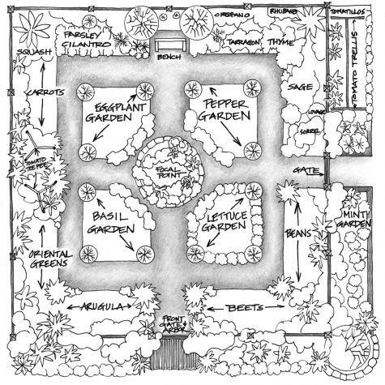
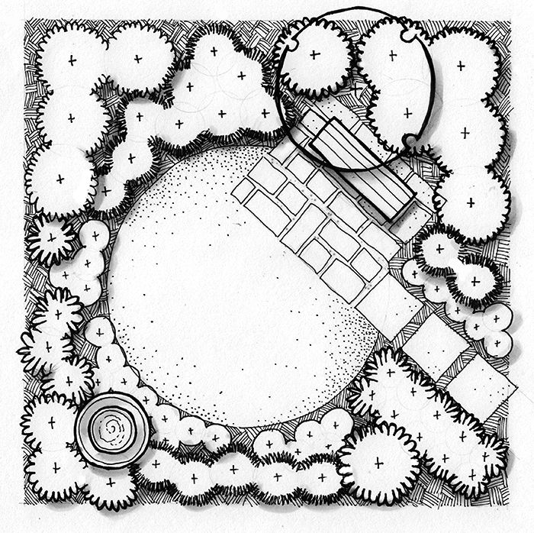
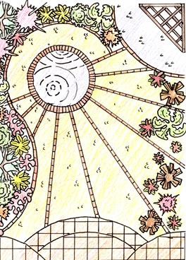
Sample Designs
Graphic Ideas:
Trees & plants, walkways, grass, pools, water feature, trellis/ pergolas, tables, decks ect.

Slide 21
Step 4: Design Time!
Row of Trees
Veggie garden
Deck
Fire Pit Seating
Area
Bubble Diagram
Concept #1- 5 min
Bees
Fruit Trees
The Edible Landscape!
Client #1: The Chef
Bench
Fire place
Raised vegetable beds
Lissa Schoot Uiterkamp
July 23

Slide 22
Step :4 Design Time!
Row of Trees
Fruit Trees
Fire Pit Seating
Area
Veggie garden
Bubble Diagram
Concept #2- 5 min
Deck
Bees
The Edible Landscape!
Client #1: The Chef
Bench
Fire place
Raised vegetable beds
Lissa Schoot Uiterkamp
July 23

Slide 23
Step 4: Design Time!
Final Design
HAPPY DESIGNING!
The Edible Landscape!
Client #1: The Chef
Bench
Fire place
Raised vegetable beds
Lissa Schoot Uiterkamp
July 23

Slide 24
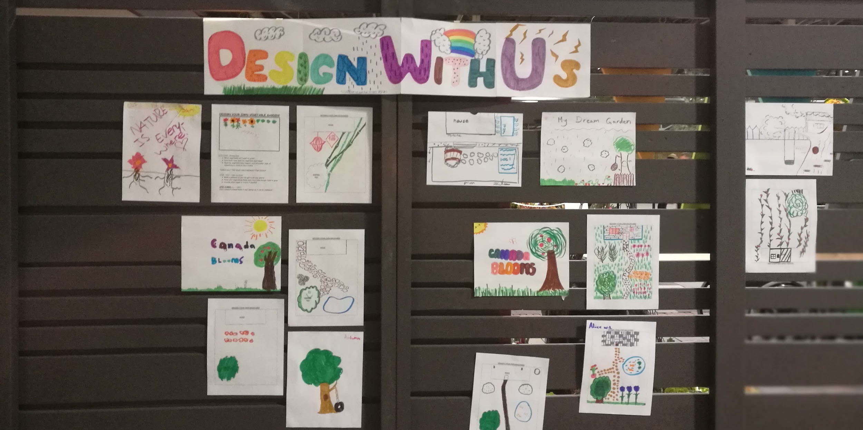
Share your Designs! :)
Notes:
https://docs.google.com/forms/d/e/1FAIpQLScO3B27ke8pGtqaTpnczRWLVvGvs2jnR-oqc1fW8zNeI0M_NQ/viewform?usp=sf_link

Slide 25
Careers!

Slide 26
Careers in Landscape Design
Notes:
2

Slide 27
CAREERS!
Notes:
2

Slide 28
PATHWAYS INTO THE PROFESSION!
Interested & have questions?
VISIT
CONTACT US!
Lissa@landscapeontario.com
Sally@landscapeontario.com
Cassandra@landscapeontario.com
OYAP/ SHSM / CO-OP/ Dual Credit
PATHWAYS
Direct to Workforce
Apprenticeship Program
College / University
Notes:
2

Slide 29
Any Questions?
CLIMATE CHANGE
CAREERS
EDUCATION
GREEN INFRASTRUCTURE
OPPORTUNITIES
SECTOR SKILLS

Slide 30
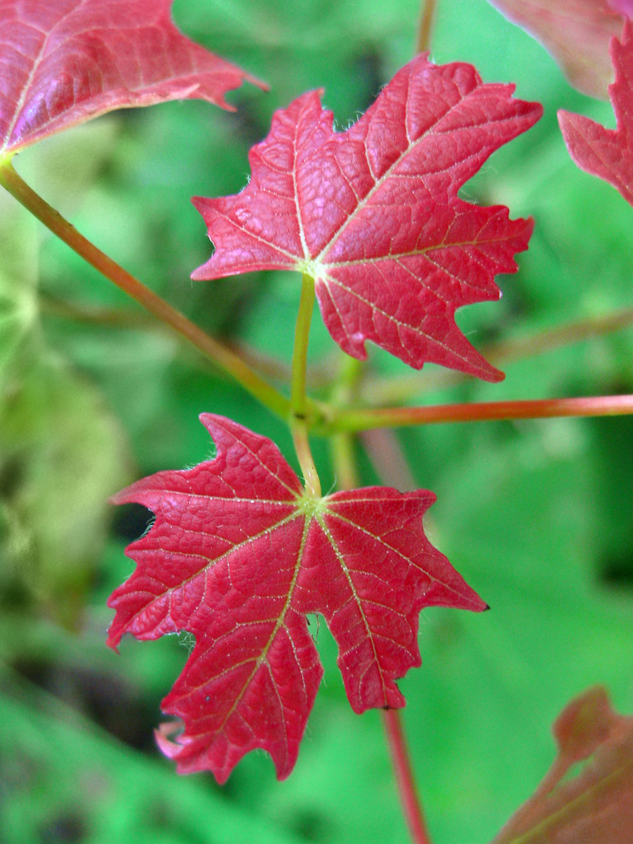
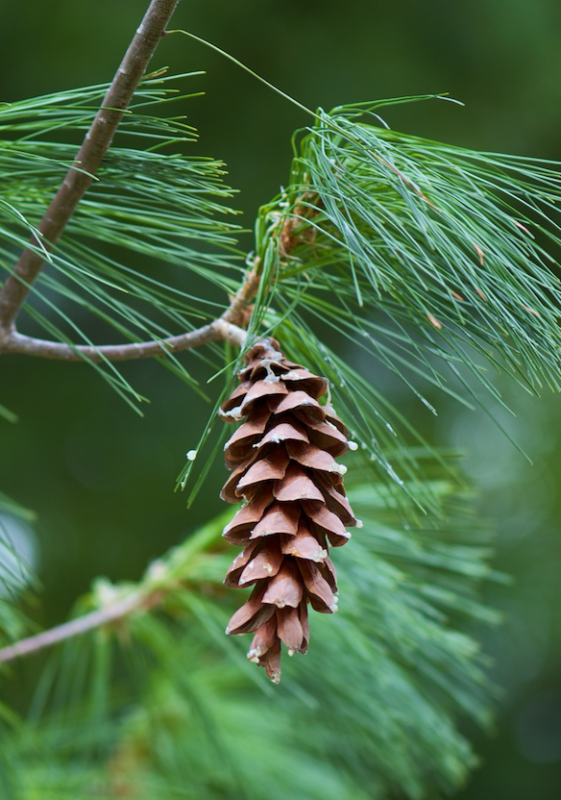
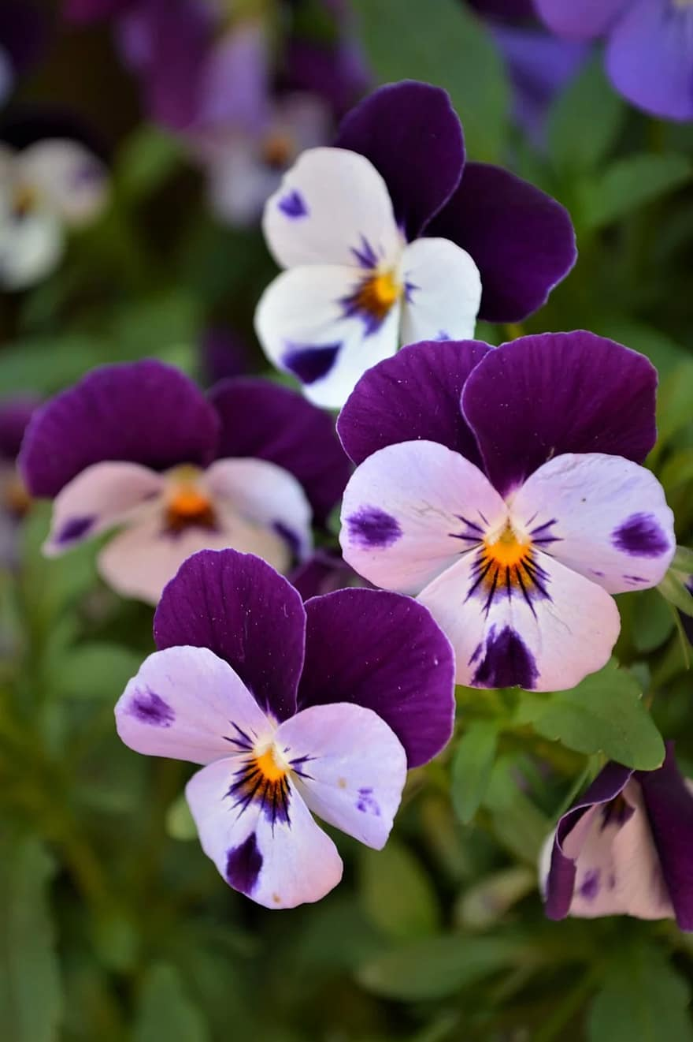
Guess That Plant
Use the sheet attached to your activity package and the clues provided to discover each plant
Sugar Maple
Witch-hazel
White Pine
Pansy
Dogwood
Sugar maple
HINT: It’s a pretty sweet plant
HINT: It’s a great Halloween costume
HINT: A character with 7 Dwarves
HINT:This plant is not cowardly
HINT: It’s got a pretty loud bark
Witch hazel
White pine
Pansy
Dogwood
acer saccharum
hamamelis sp.
pinus stobus
viola tricolor
cornus sericea

