Slide 1
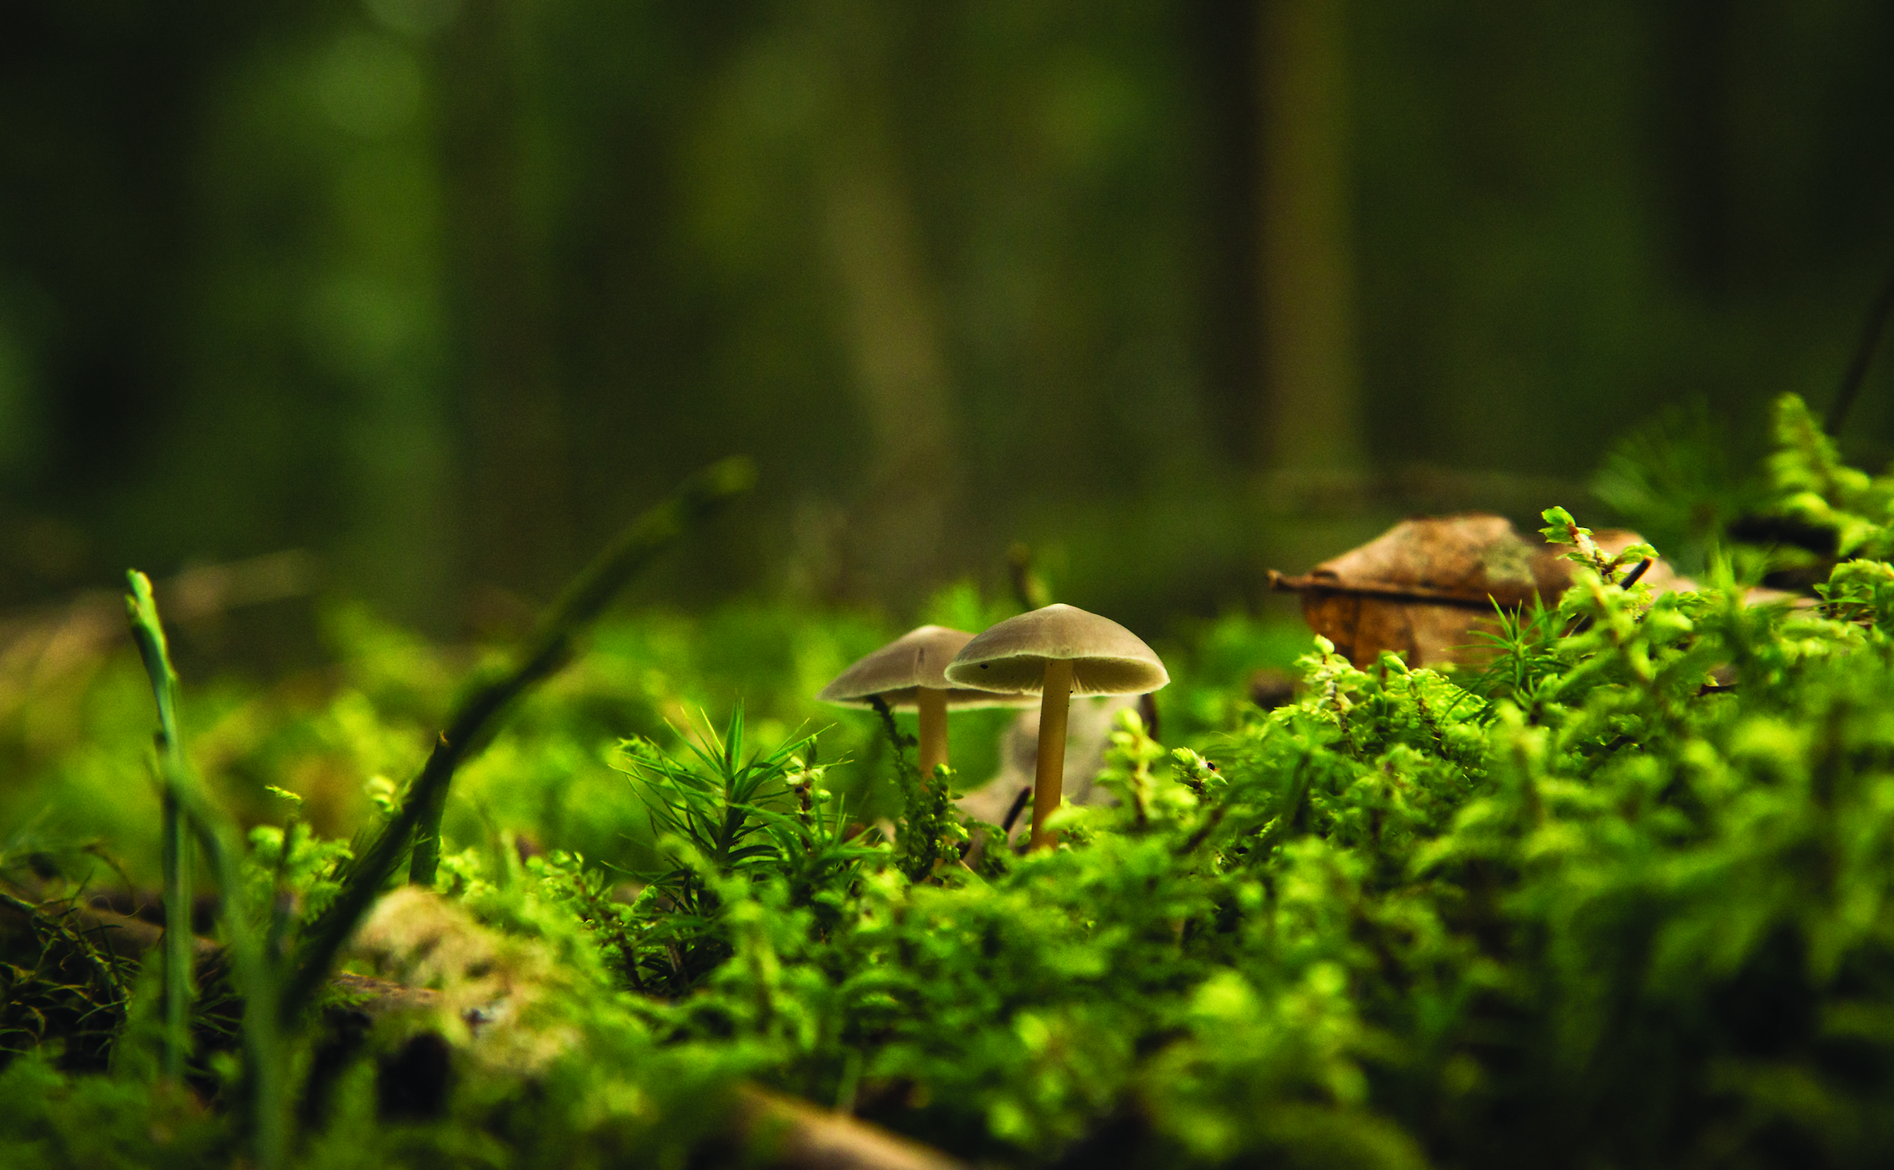
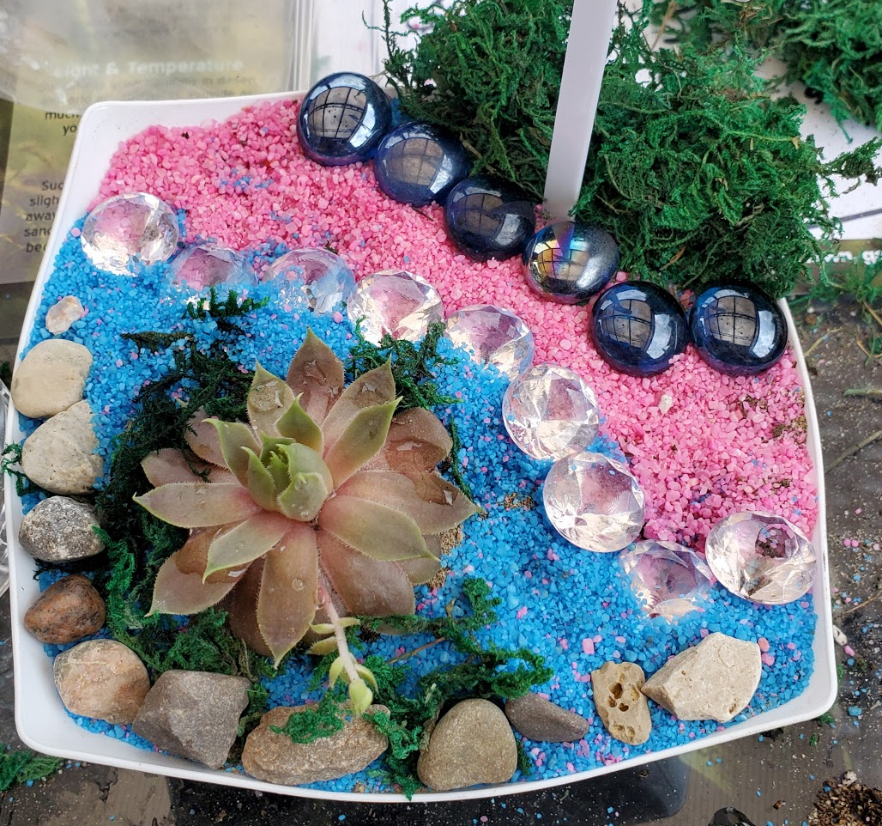
DESIGN, BUILD & MAINTAIN YOUR OWN MINIATURE LANDSCAPE
Outcome
Students can design and build their very own miniature landscape that can be kept on a table and cared for. Use this activity to introduce the cool careers that exist in the landscape horticulture profession and provide students with the opportunity to walk in a landscape horticulture professionals shoes.
Preparation
Print activity worksheet or send digital copy to students
Customize powerpoint file
Gather materials or send materials list to students
Materials List
Activity Worksheet
Plant (3" succulent)
Container (clear 6" plastic bowl - dollar store)
Gravel (different colours- dollar store)
Drainage gravel/ stones (pea gravel, or granular- home depot)
Sphagnum moss (dollar store)
Potting soil (home depot)
Coffee filters for landscape fabric

