Slide 1
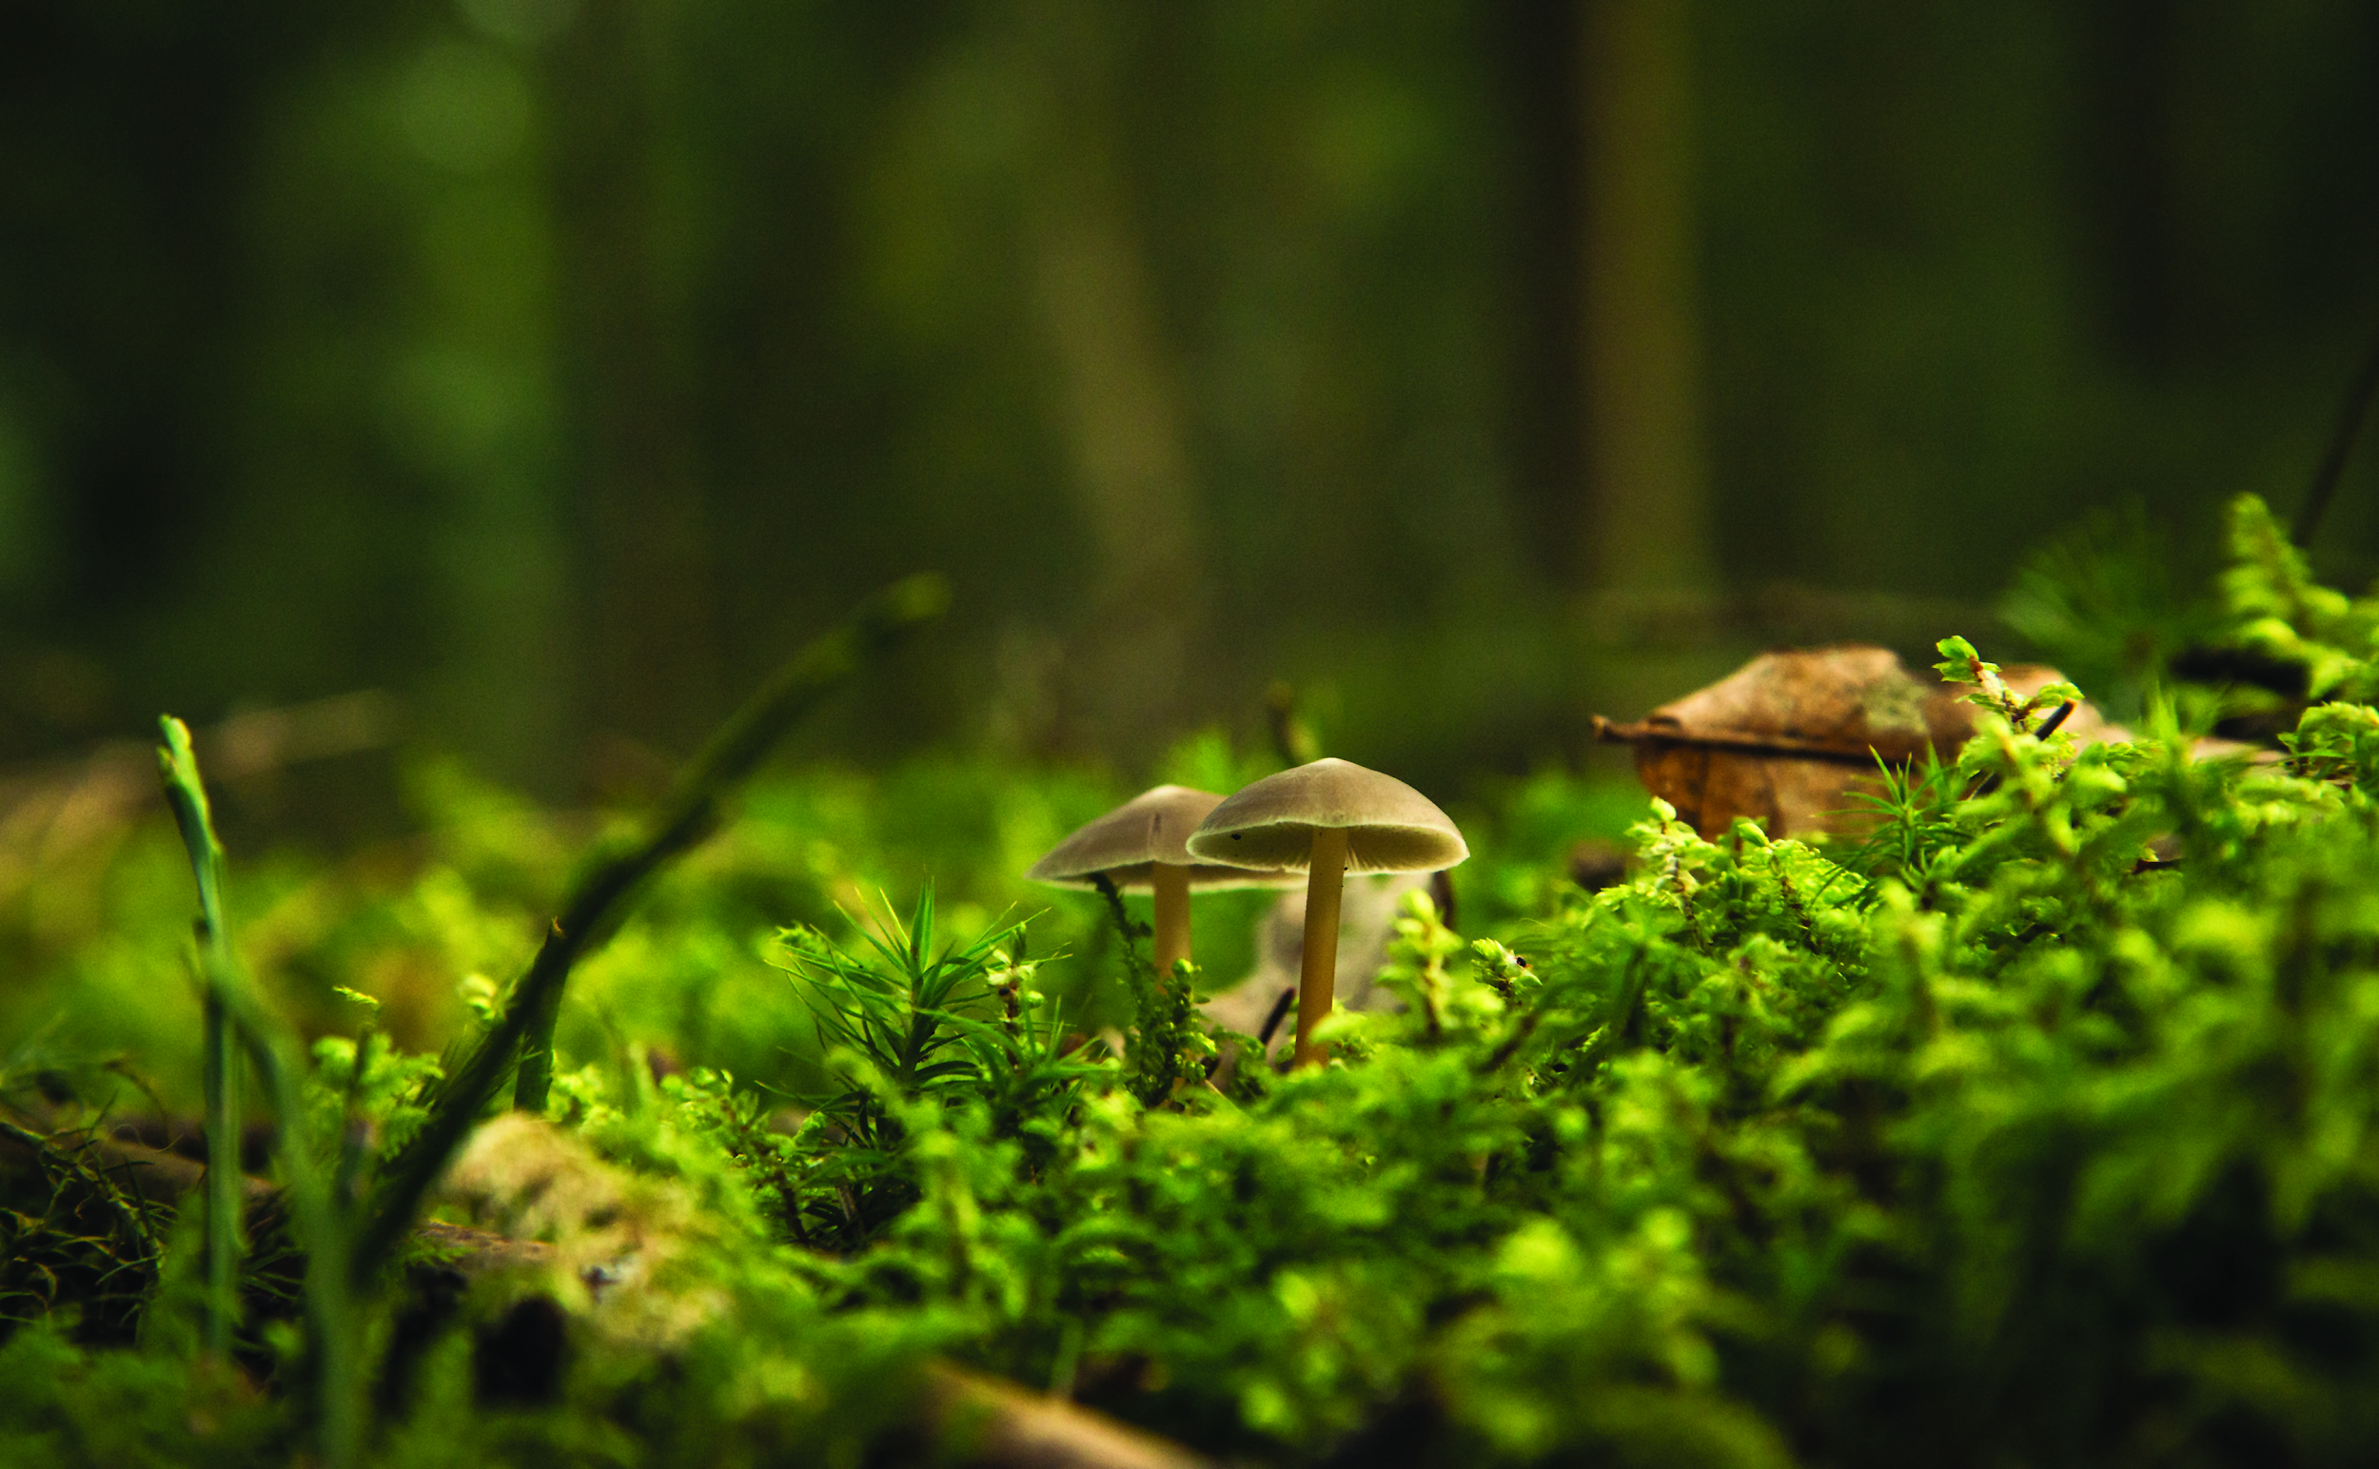

Welcome!
DESIGN, BUILD & MAINTAIN YOUR OWN MINIATURE LANDSCAPE

Slide 2
Today’s Schedule
Introductions
2) Activity
3) Careers

Slide 3
Workshop Leaders
Feel free to ask us any questions throughout the workshop!
Name
Name

Slide 4


Getting to Know You!
https://www.wearebloom.org/
Notes:
2 min
https://www.wearebloom.org/

Slide 5










Notes:
2 min

Slide 6
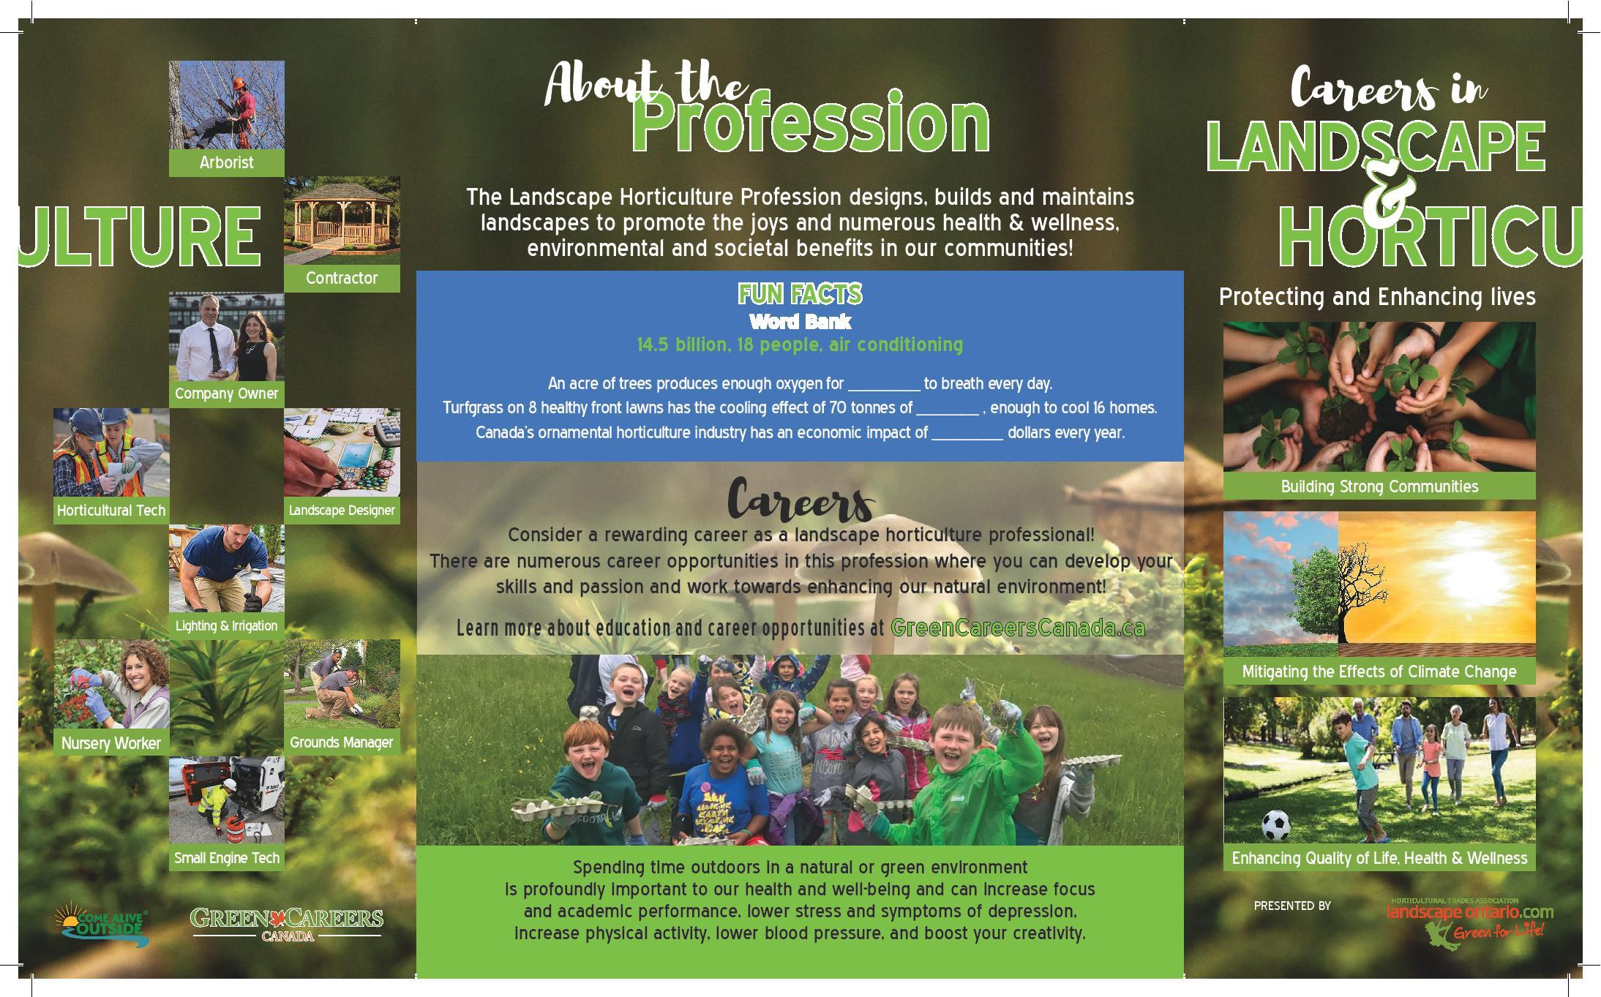
Landscape Ontario Horticultural Trades Association
Our Members Protecting and Enhancing lives through
Designing, Building & Maintaining Green Infrastructure
Notes:
5min
Quality of life Health and Wellness
Physical
Improve air quality
Green spaces that remain cooler in summer months
Provide safe spaces for people of all ages to play games and sports to get active
Mental
Provide spaces for horticulture therapy
Strengthen a communities connection with nature (reduce the negative effects of nature deficit disorder)
Provide peaceful places that escape everyday life for contemplation and reflection
Building Strong Communities
Designing, building and maintaining aging park systems
Creating a network of corridors that connect people to public spaces
Protecting naturally significant areas
Environmental Stewardship
Native plantings to increase biodiversity
Municipalities that are mandated by their official plans to increase their canopy cover
Flood and erosion prevention and protection
Reduction in the urban heat island effect and creation or micro climates to provide more enjoyable places to enjoy the out doors

Slide 7
Become a Landscape Professional!
DESIGN, BUILD & MAINTAIN YOUR OWN MINIATURE LANDSCAPE

Slide 8
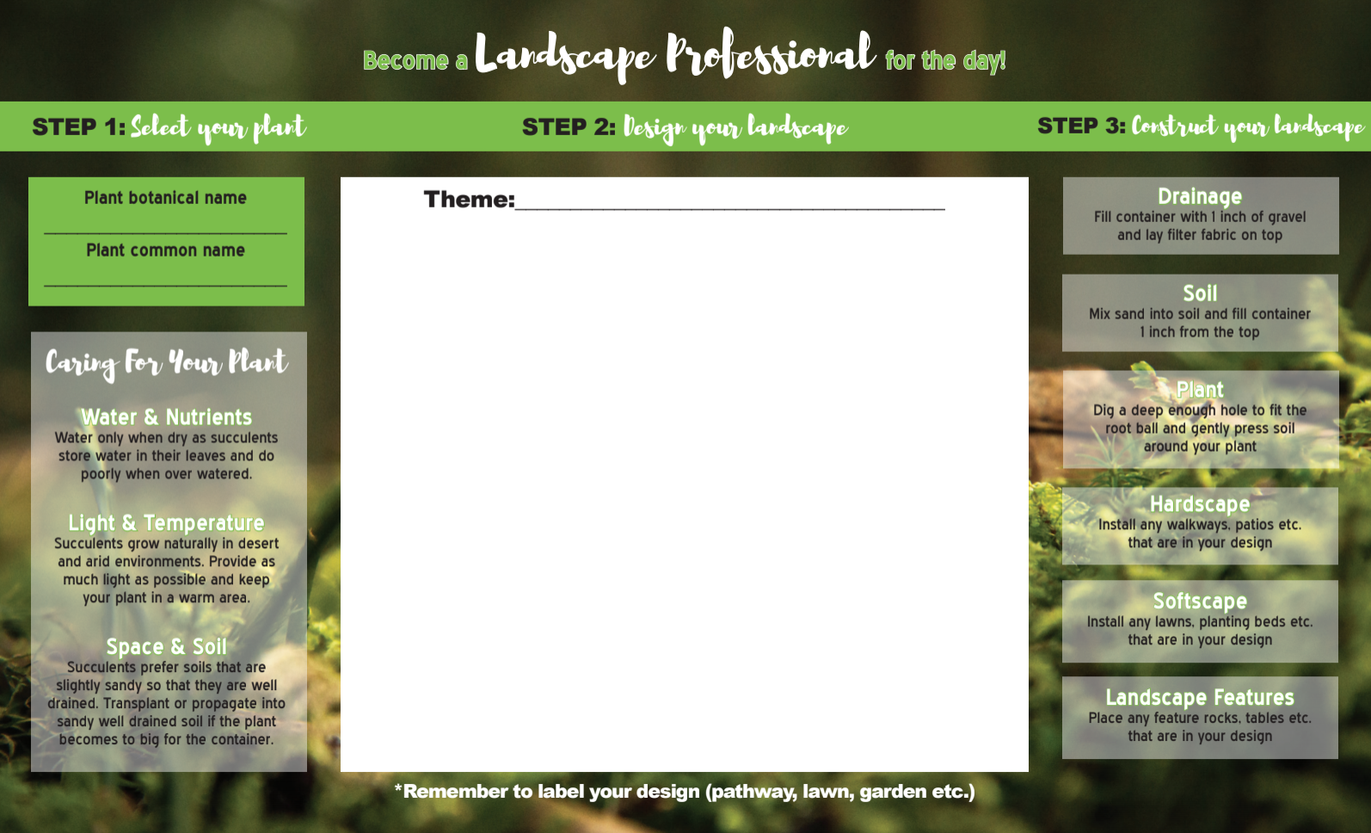
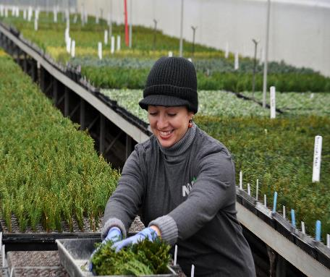
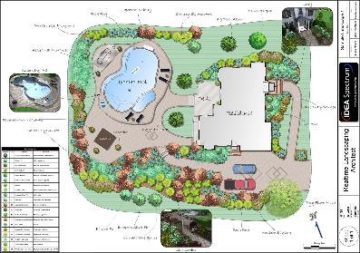
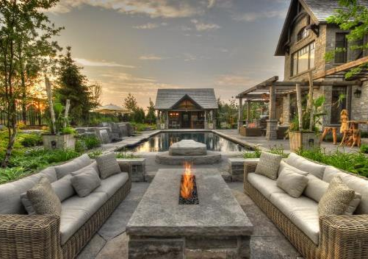
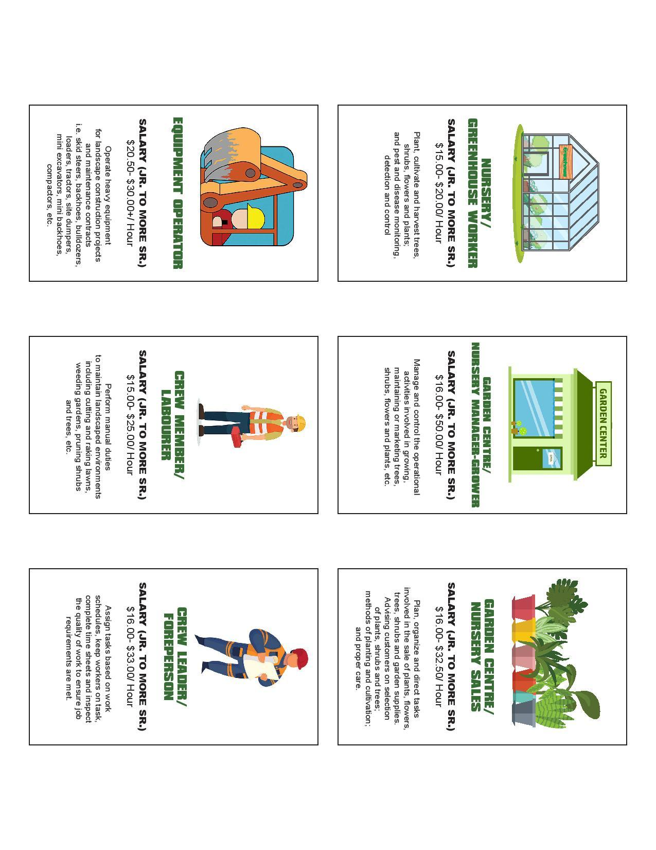
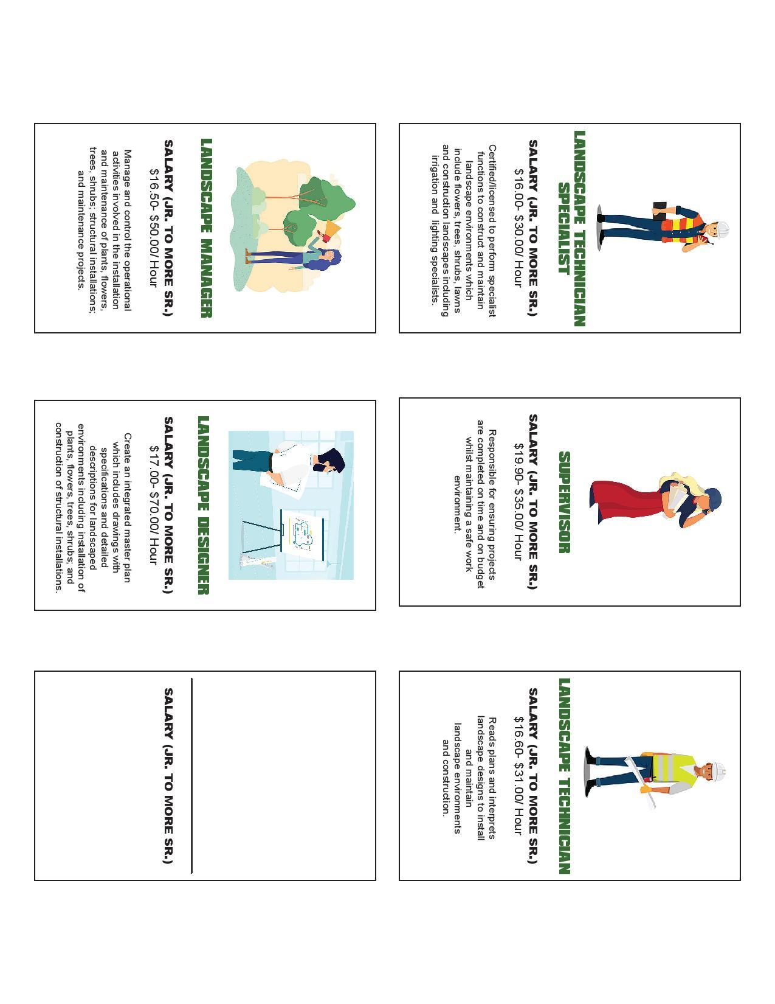
Notes:
2

Slide 9
Grab your Activity box
A pencil or pen
and
A pair of Scissors
Optional: Pencil crayons or markers
Notes:
Take out and organize box

Slide 10
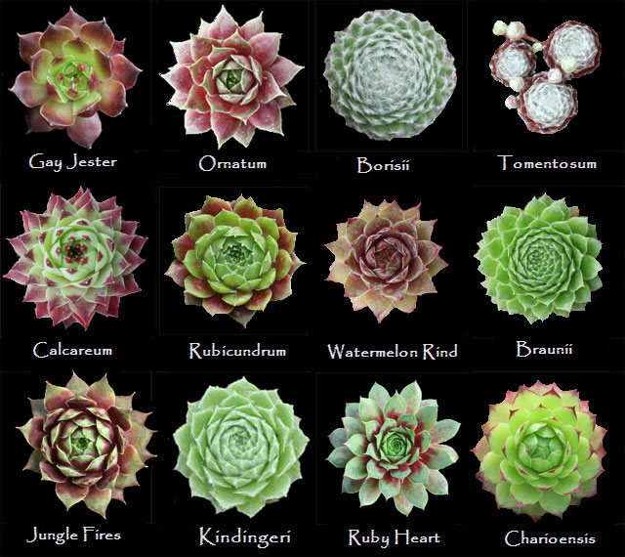
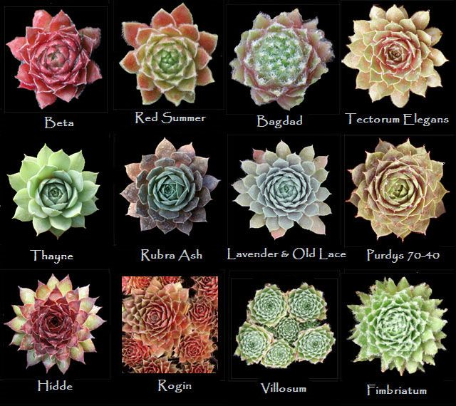
BOTANICAL NAME
Sempervivum tectorum _______________
(genus ) (species) (variety)
COMMON NAME(s)
Hens and chicks, houseleek, hen-widdies
Notes:
5

Slide 11
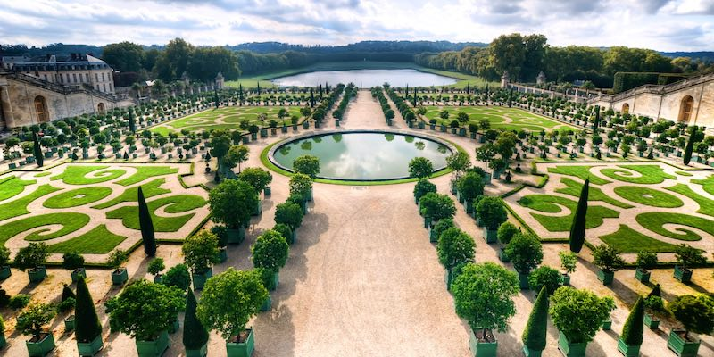
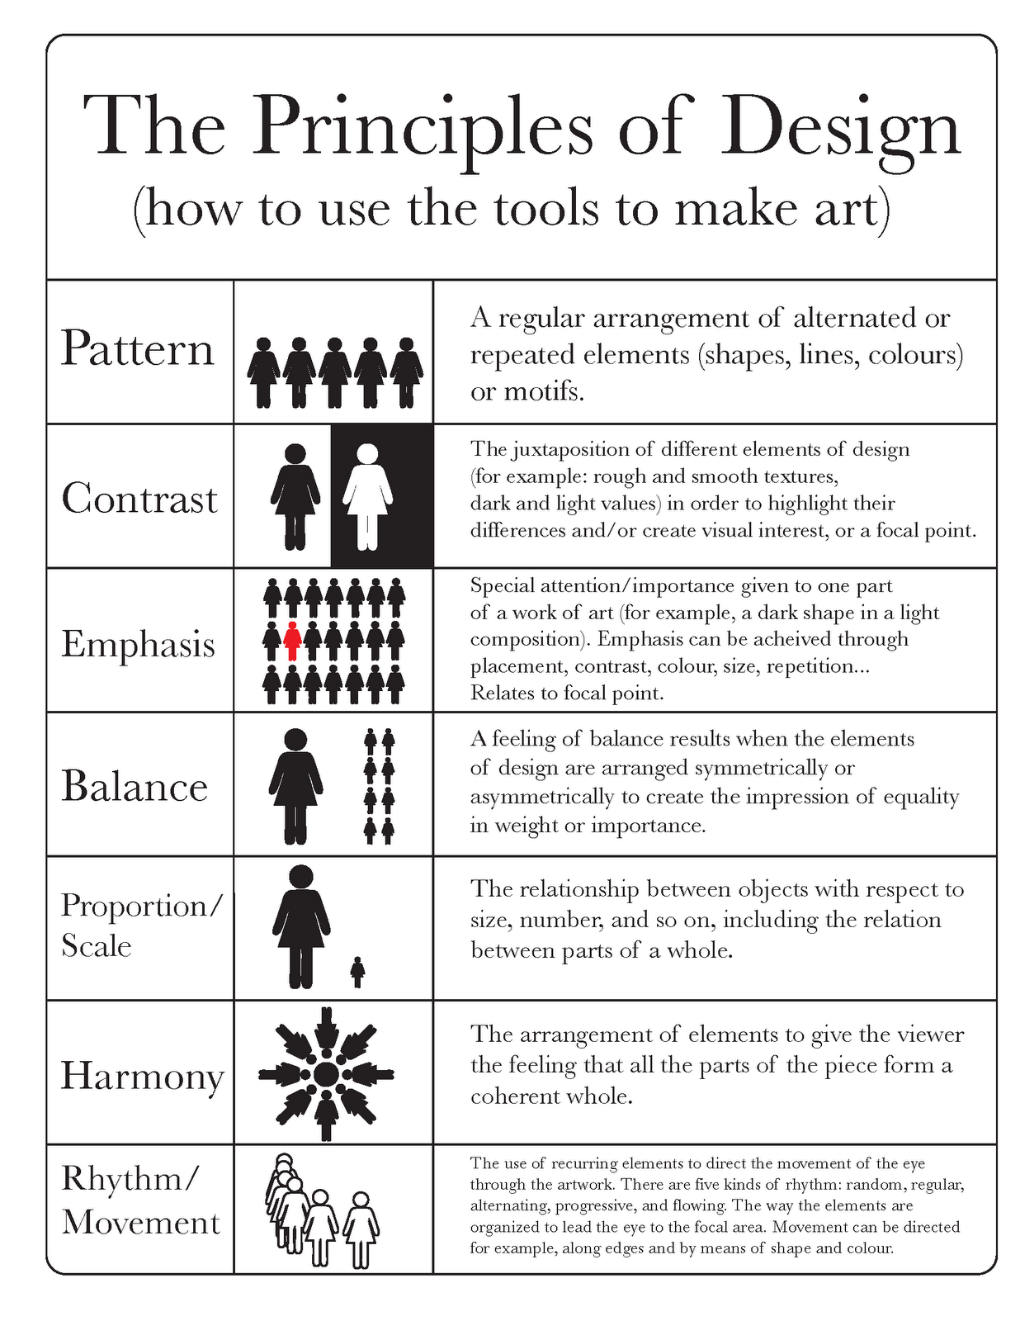


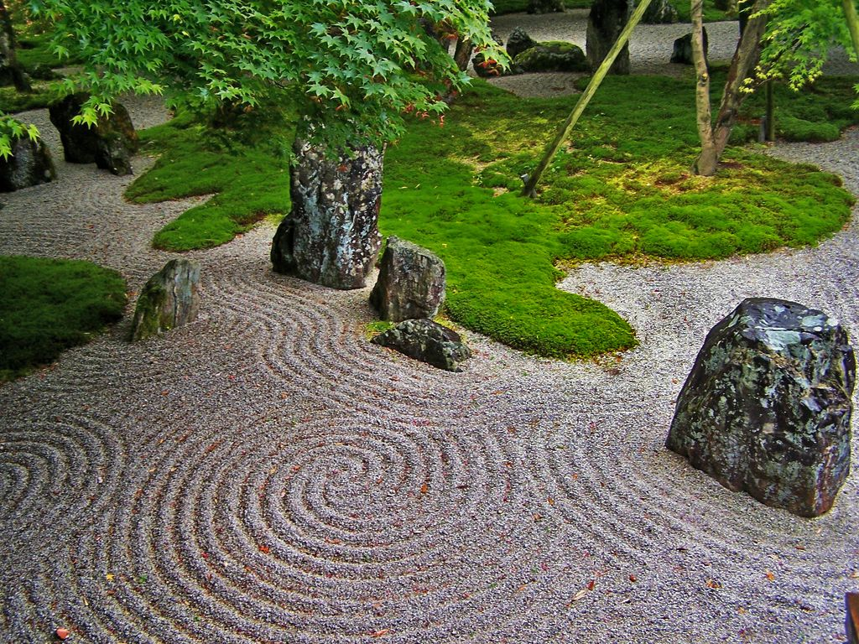
Design Principles
Client #1
- Versailles is their all time favourite garden
- They like things to be symmetrical
- Like order, balance & clean crisp lines
Repetition->
Variety ->
Balance ->
Emphasis->
Scale ->
Sequence->
Client #2
- Loves to paint
- Has a house full of bright bold colours
- Wants to be able to paint his garden at all time of the year
Client #3
- Visited a rock garden in Japan and loved it!
- Wants to conserve water (Xeriscaping)
- Wants a minimalistic low maint. landscape
Client #4
- YOU! :)
Notes:
10

Slide 12
Notes:
15

Slide 13
Notes:
Hens and chicks are also very shallow-rooted, which means you can grow them in very small, miniature or shallow containers. They are drought and neglect tolerant to the extreme and are also cold hardy to zone three which is a whopping -35 F. They are also hardy in the balmy climate of zone eight.

Slide 14
Showcase your work!

Slide 15
Careers!

Slide 16
Notes:
2

Slide 17

CAREERS!
Notes:
2
Landscape ontario represents 10 sectors- garden centres, grounds managment, growers, interior plant scape, irrigation, landscape contractors, landscape design, lighting, snow& ice management, turf managment

Slide 18


PATHWAYS INTO THE PROFESSION!
Interested & have questions?
VISIT
CONTACT US!
Lissa@landscapeontario.com
Sally@landscapeontario.com
Cassandra@landscapeontario.com
OYAP/ SHSM / CO-OP/ Dual Credit
PATHWAYS
Direct to Workforce
Apprenticeship Program
College / University
Notes:
2

Slide 19


Any Questions?
CLIMATE CHANGE
CAREERS
EDUCATION
GREEN INFRASTRUCTURE
OPPORTUNITIES
SECTOR SKILLS

Slide 20
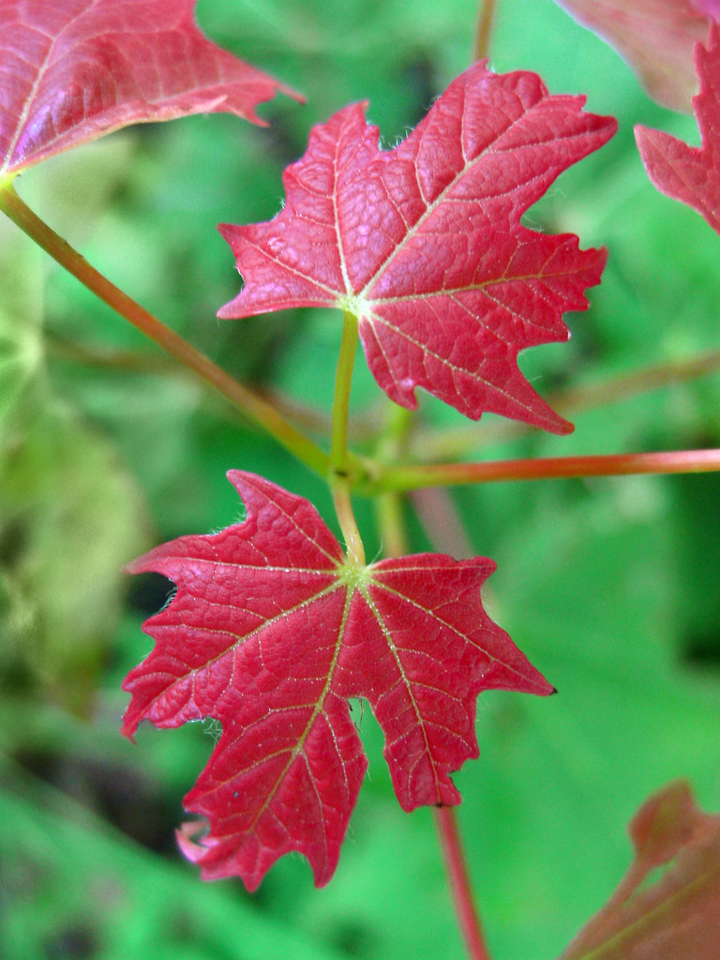
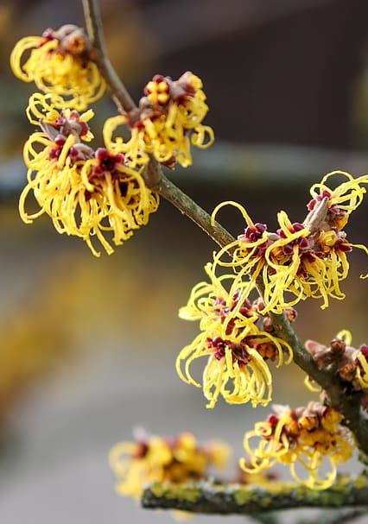
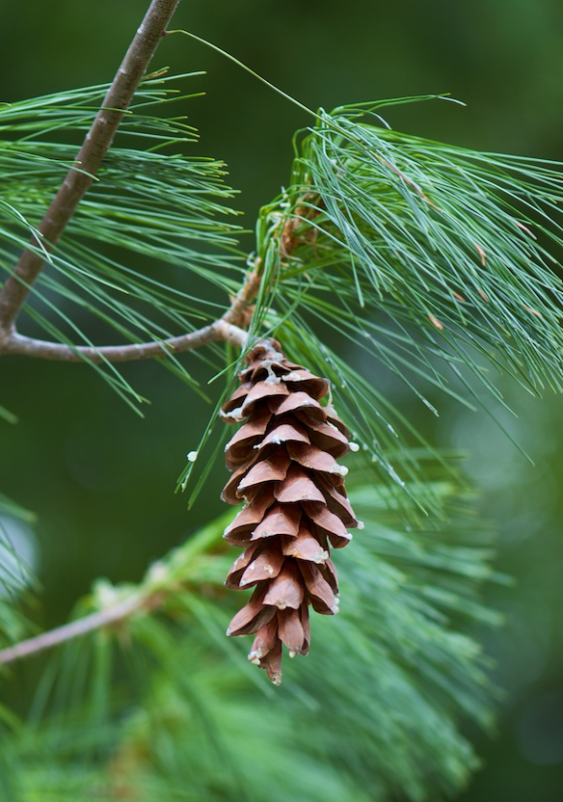
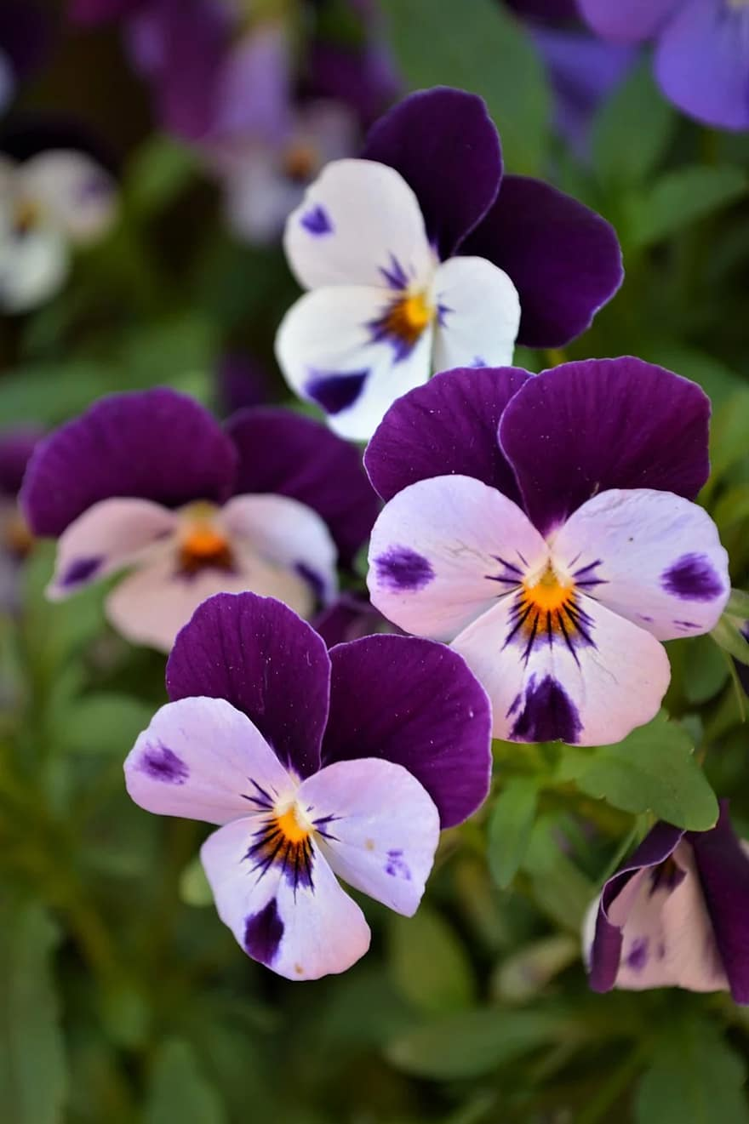
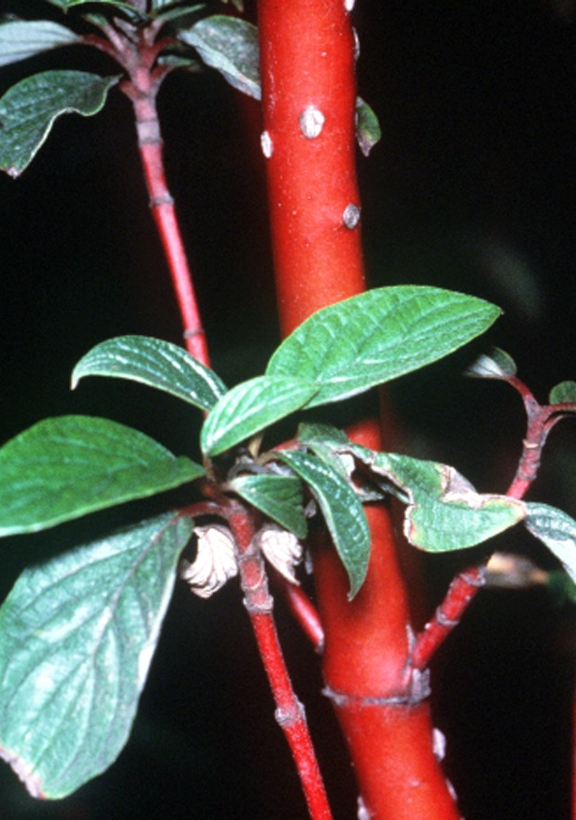
Guess That Plant
Use the sheet attached to your activity package and the clues provided to discover each plant
Sugar Maple
Witch-hazel
White Pine
Pansy
Dogwood
Sugar maple
HINT: It’s a pretty sweet plant
HINT: It’s a great Halloween costume
HINT: A character with 7 Dwarves
HINT:This plant is not cowardly
HINT: It’s got a pretty loud bark
Witch hazel
White pine
Pansy
Dogwood
acer saccharum
hamamelis sp.
pinus stobus
viola tricolor
cornus sericea

