Slide 1
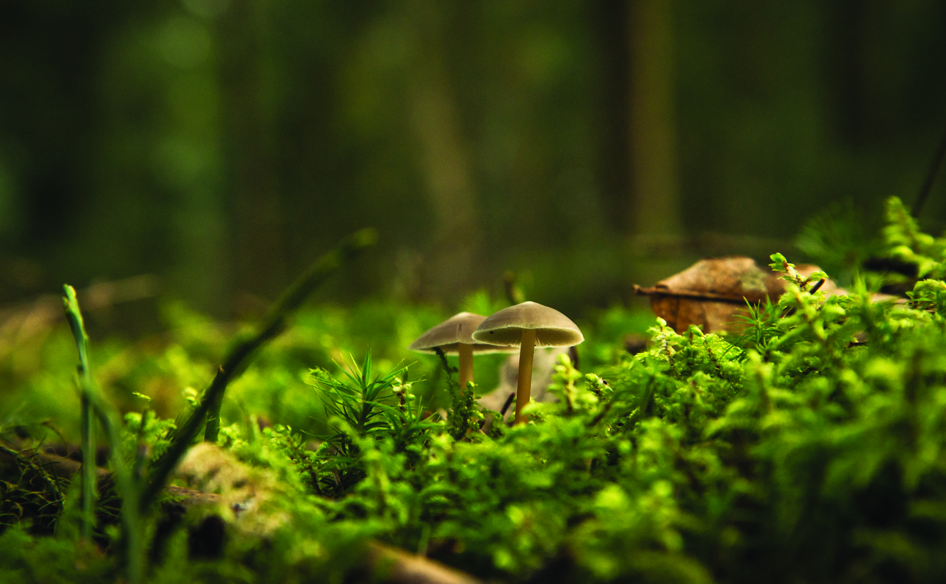
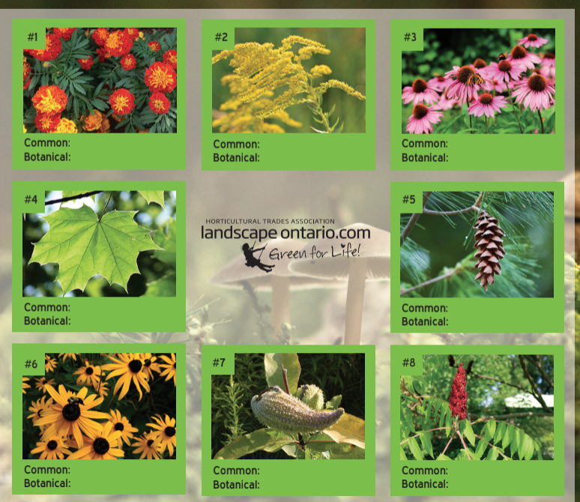

THE FASCINATING WORLD OF PLANTS
Outcome
Teach students about the fascinating & diverse world of plants by taking a virtual plant walk. Teach students how plants support biodiversity and some of their many cool uses such as being used to dye fabric and make medicine! This activity will teach students about different plant types (trees, shrubs, annuals, perennials), what animals are attracted to them and how to grow plants. Have students participate in a plant scavenger hunt to explore the plants in their house, backyard or neighbourhood! Students will be taught how to identify plants in their community and share this knowledge with others using painted rock name plates and pressed flowers.
Preparation
Print activity worksheet or send digital copy to students
Customize powerpoint file
Gather materials or send materials list to students
Materials List
Activity Worksheet
Camera/ phone (download google lens or Seek apps for plant identification)
Round Rock(s)
Waterproof paint or markers
Cardboard
Heavy book
Paper
Plant leaf flower or petal(s)

