Slide 1
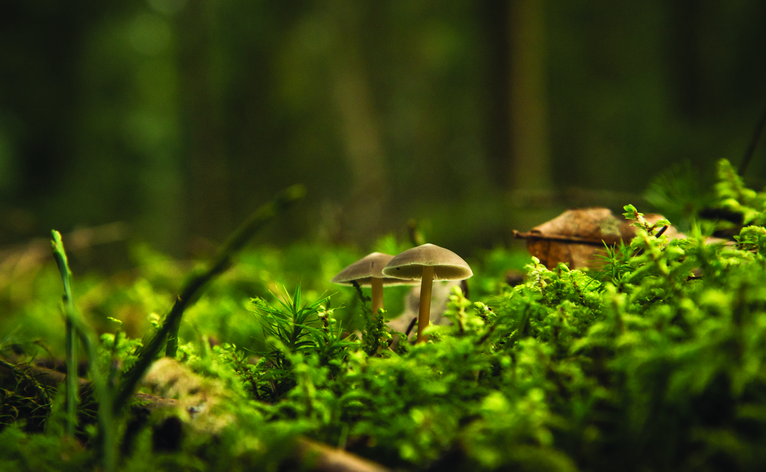
Welcome!
THE FASCINATING WORLD OF PLANTS

Slide 2
Today’s Schedule
Introductions
2) Activity
3) Careers

Slide 3
Workshop Leaders
Feel free to ask us any questions throughout the workshop!
Name
Name

Slide 4
Landscape Ontario
Protecting and Enhancing lives through
Designing, Building & Maintaining Green Infrastructure
Notes:
5min
Quality of life Health and Wellness
Physical
Improve air quality
Green spaces that remain cooler in summer months
Provide safe spaces for people of all ages to play games and sports to get active
Mental
Provide spaces for horticulture therapy
Strengthen a communities connection with nature (reduce the negative effects of nature deficit disorder)
Provide peaceful places that escape everyday life for contemplation and reflection
Building Strong Communities
Designing, building and maintaining aging park systems
Creating a network of corridors that connect people to public spaces
Protecting naturally significant areas
Environmental Stewardship
Native plantings to increase biodiversity
Municipalities that are mandated by their official plans to increase their canopy cover
Flood and erosion prevention and protection
Reduction in the urban heat island effect and creation or micro climates to provide more enjoyable places to enjoy the out doors

Slide 5
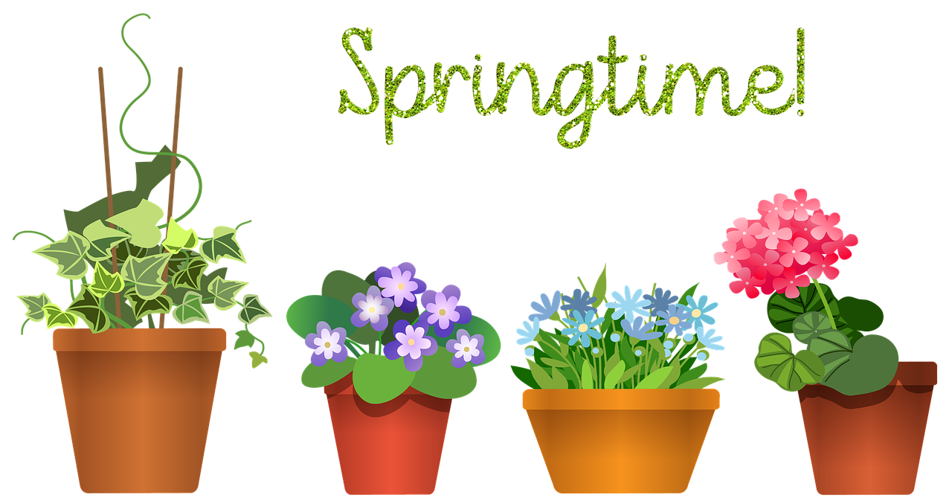
Getting to Know You!
What is your favourite plant!
Or
What plant are you currently growing!

Slide 6
Activity!
Plant Scavenger Hunt!
Rocking labels & cards

Slide 7
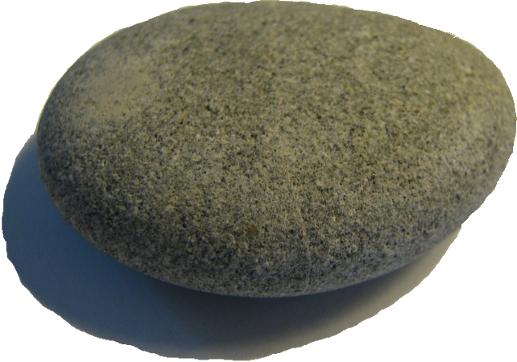
Gather Materials
Painted Rocks
Leaf Press
Notes:
Dichotomous key activity: https://fergusonfoundation.org/btw-students/plant-identification/

Slide 8
Plant Scavenger Hunt!
Step 1:
Select & identify a plant
Step 2:
Create a plant label that ROCKS
Step 3:
Find your plant and place your label!
Step 4:
Pick a petal or leaf from your plant and press it!
Step 5:
Create a pressed leaf card & send it
Notes:
Dichotomous key activity: https://fergusonfoundation.org/btw-students/plant-identification/

Slide 9
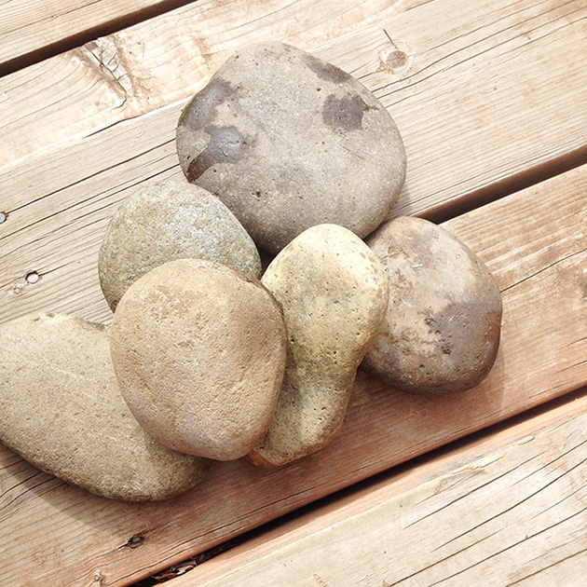
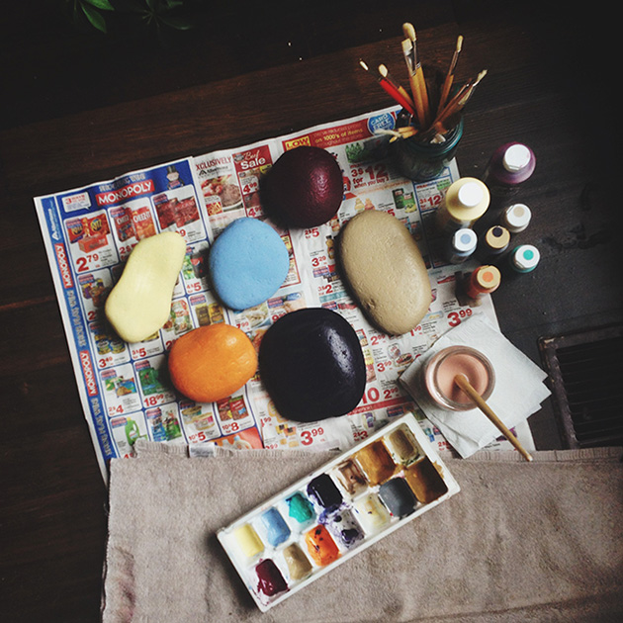
Prepare Materials
1) Clean your rock(s)
2) Paint a base coat
Notes:
Dichotomous key activity: https://fergusonfoundation.org/btw-students/plant-identification/

Slide 10
Step 1: Select & identify your plant!
Flower or fruit
Shape, size, colour
Leaf
Shape, margin, arrangement
Stem
Texture
Google Lens
Free Plant ID App
Notes:
Dichotomous key activity: https://fergusonfoundation.org/btw-students/plant-identification/

Slide 11
Step 1: Select & identify your plant!
Flower or fruit
Shape, size, colour
Leaf
Shape, margin, arrangement
Stem
Texture
Google Lens
Free Plant ID App
Notes:
Dichotomous key activity: https://fergusonfoundation.org/btw-students/plant-identification/

Slide 12
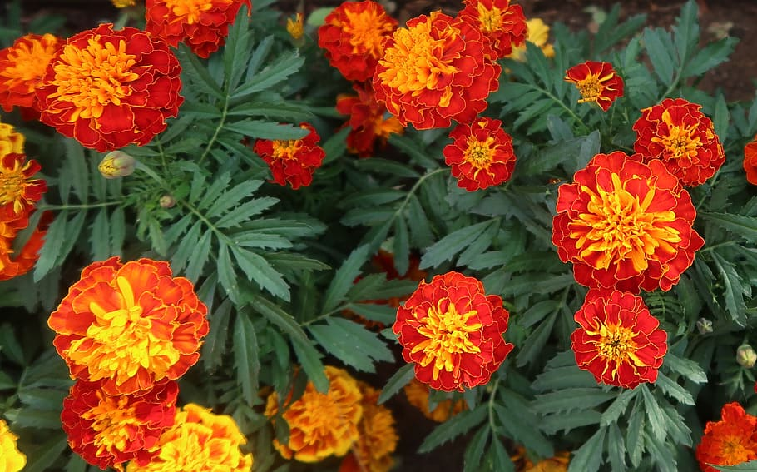
Plant #1
#1
What Do I Look Like?
Flower & Fruit, Leaf, Stem
Where Can You Find Me?
Hardiness, native vs cultivated, common uses
Fun Fact!
Common:
Botanical:
marigold
Tagetes sp.
Notes:
Edible flowers and can be used in salads or on sweet pastries!
Some gardeners plant marigold in their vegetable gardens to protect vegetables from the pests. Insect repelling properties of marigold are not scientifically proven yet.

Slide 13
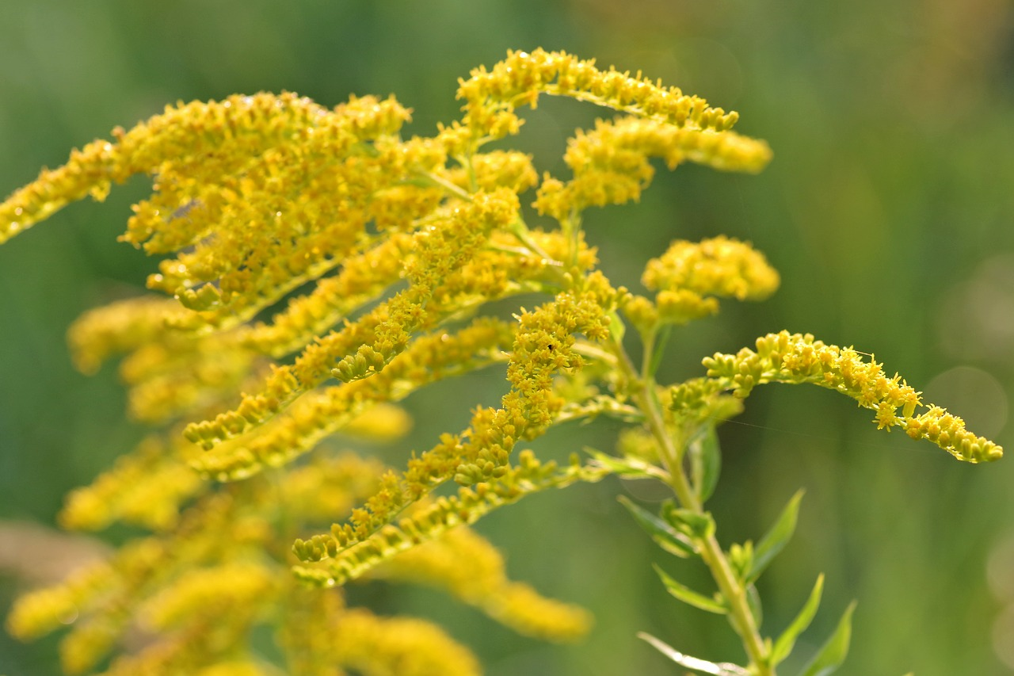
Plant #2
#2
What Do I Look Like?
Flower & Fruit, Leaf, Stem
Where Can You Find Me?
Hardiness, native vs cultivated, common uses
Fun Fact!
Common:
Botanical:
Canadian goldenrod
Solidago canadensis
Notes:
reduce pain and swelling (inflammation), as a diuretic to increase urine flow, and to stop muscle spasms. It is also used for gout, joint pain (rheumatism), arthritis, as well as eczema and other skin conditions

Slide 14
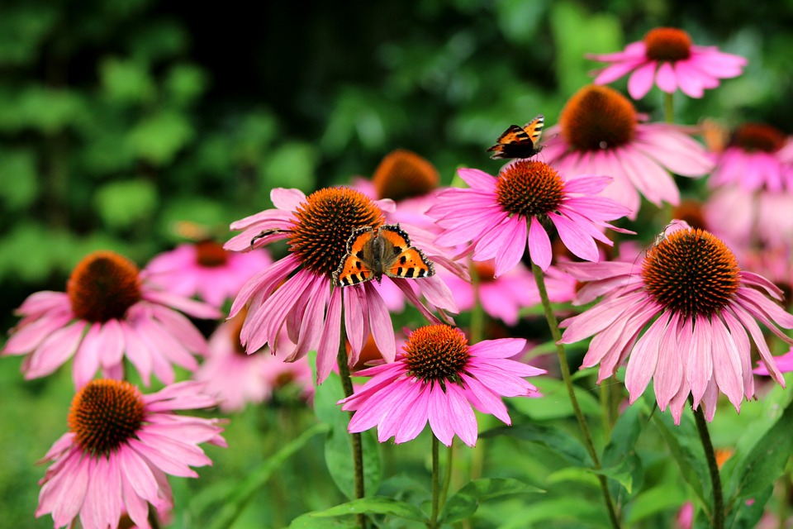
Plant #3
#3
What Do I Look Like?
Flower & Fruit, Leaf, Stem
Where Can You Find Me?
Hardiness, native vs cultivated, common uses
Fun Fact!
Common:
Botanical:
purple coneflower
Echinacea purpurea
Notes:
customarily as a treatment for the common cold, coughs, bronchitis, upper respiratory infections, and some inflammatory conditions

Slide 15
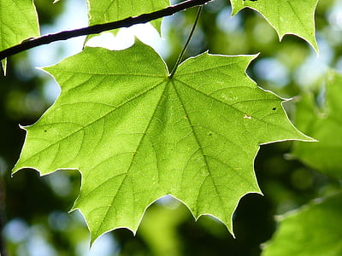
Plant #4
#4
What Do I Look Like?
Flower & Fruit, Leaf, Stem
Where Can You Find Me?
Hardiness, native vs cultivated, common uses
Fun Fact!
Common:
Botanical:
sugar maple
Acer saccharum

Slide 16
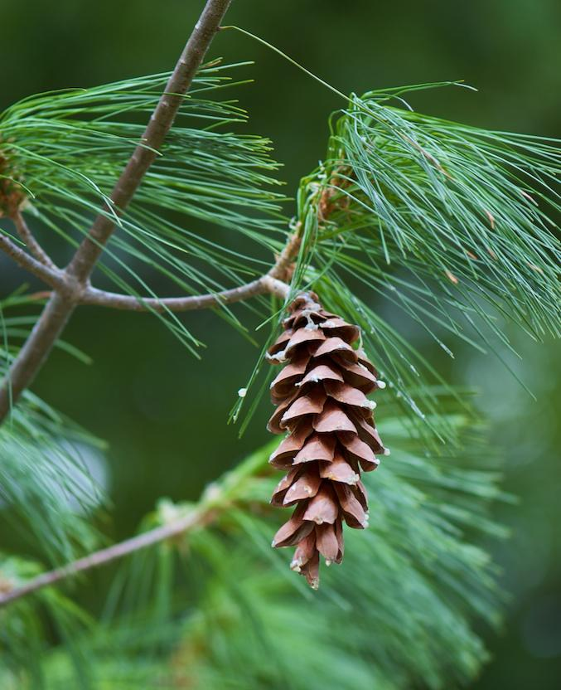
Plant #5
#5
What Do I Look Like?
Flower & Fruit, Leaf, Stem
Where Can You Find Me?
Hardiness, native vs cultivated, common uses
Fun Fact!
Common:
Botanical:
white pine
Pinus strobus

Slide 17
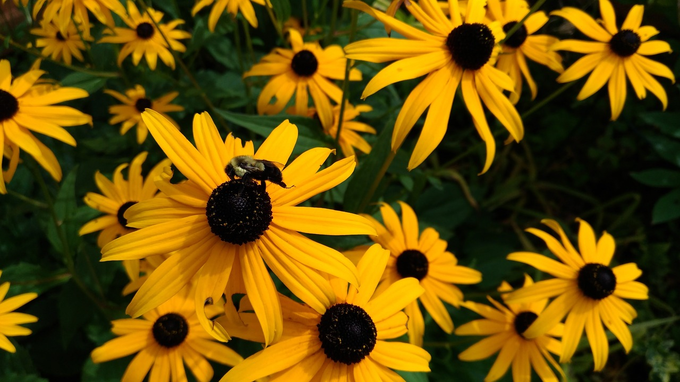
Plant #6
#6
What Do I Look Like?
Flower & Fruit, Leaf, Stem
Where Can You Find Me?
Hardiness, native vs cultivated, common uses
Fun Fact!
Common:
Botanical:
black-eyed Susan
Rudbeckia hirta

Slide 18
Plant #8
#7
What Do I Look Like?
Flower & Fruit, Leaf, Stem
Where Can You Find Me?
Hardiness, native vs cultivated, common uses
Fun Fact!
Common:
Botanical:
common milkweed
Asclepias syriaca

Slide 19
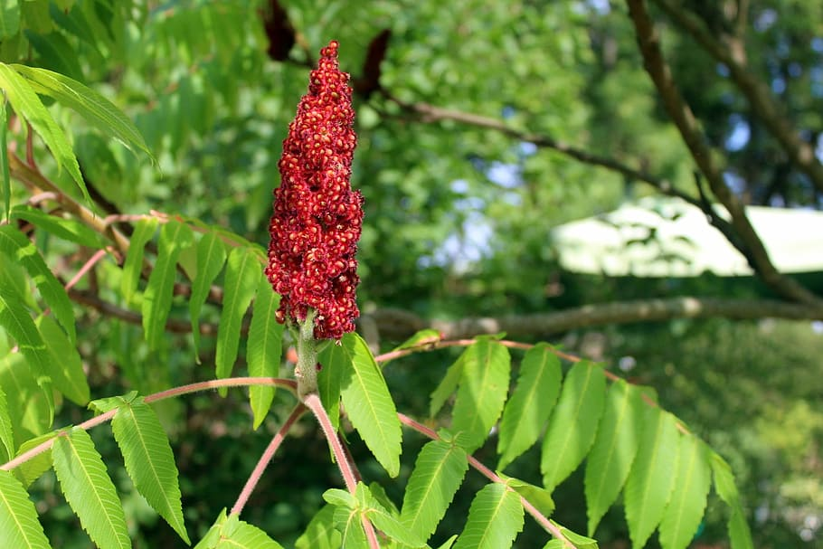
Plant #9
#8
What Do I Look Like?
Flower & Fruit, Leaf, Stem
Where Can You Find Me?
Hardiness, native vs cultivated, common uses
Fun Fact!
Common:
Botanical:
staghorn sumac
Rhus typhina
Notes:
https://www.thespruce.com/poison-sumac-vs-staghorn-sumac-4772349#:~:text=When%20we%20take%20a%20closer%20look%20at%20the,vernix%2C%20staghorn%20sumac%20is%20classified%20as%20Rhus%20typhina.#:~:text=When%20we%20take%20a%20closer%20look%20at%20the,vernix%2C%20staghorn%20sumac%20is%20classified%20as%20Rhus%20typhina.

Slide 20
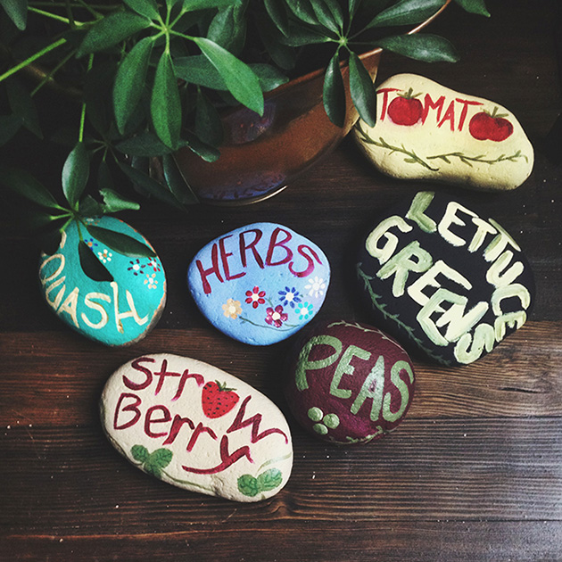
Step 2: Create a plant label that ROCKS!
3) Paint plant name
Notes:
Dichotomous key activity: https://fergusonfoundation.org/btw-students/plant-identification/

Slide 21
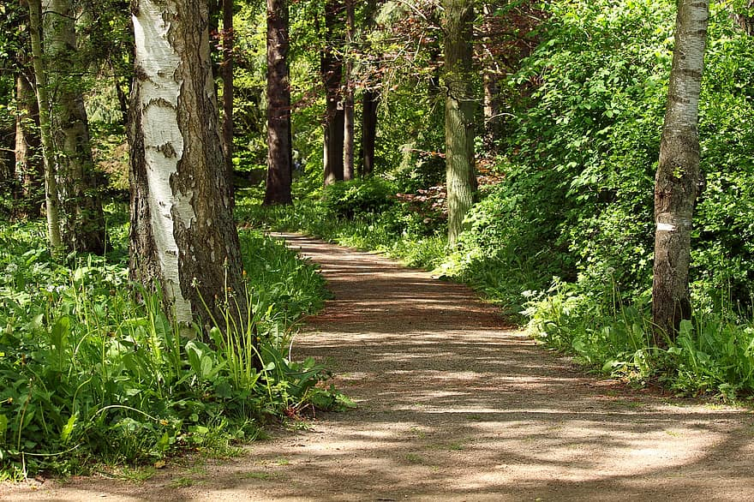
Step 3: Find your plant and place your label
Notes:
Dichotomous key activity: https://fergusonfoundation.org/btw-students/plant-identification/

Slide 22
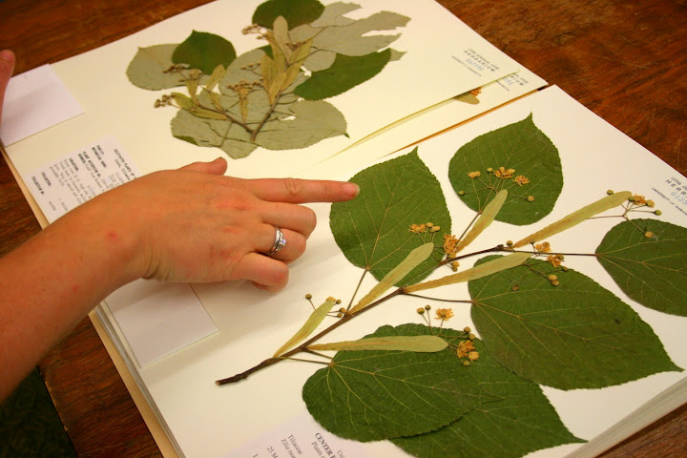
Step 4: Pick a petal or leaf from your plant and press it!
Notes:
Dichotomous key activity: https://fergusonfoundation.org/btw-students/plant-identification/

Slide 23
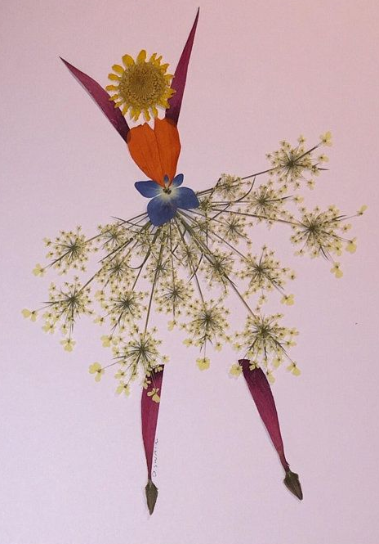
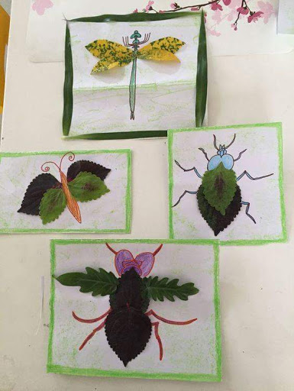
Step 5: Make and send your card!

Slide 24
Careers!

Slide 25
Careers Working With Plants
Notes:
2

Slide 26
CAREERS IN LANDSCAPE HORTICULTURE!
Notes:
2

Slide 27
PATHWAYS INTO THE PROFESSION!
Interested & have questions?
VISIT
CONTACT US!
Lissa@landscapeontario.com
Sally@landscapeontario.com
Cassandra@landscapeontario.com
OYAP/ SHSM / CO-OP/ Dual Credit
PATHWAYS
Direct to Workforce
Apprenticeship Program
College / University
Notes:
2

Slide 28
Any Questions?
CLIMATE CHANGE
CAREERS
EDUCATION
GREEN INFRASTRUCTURE
OPPORTUNITIES
SECTOR SKILLS

Slide 29
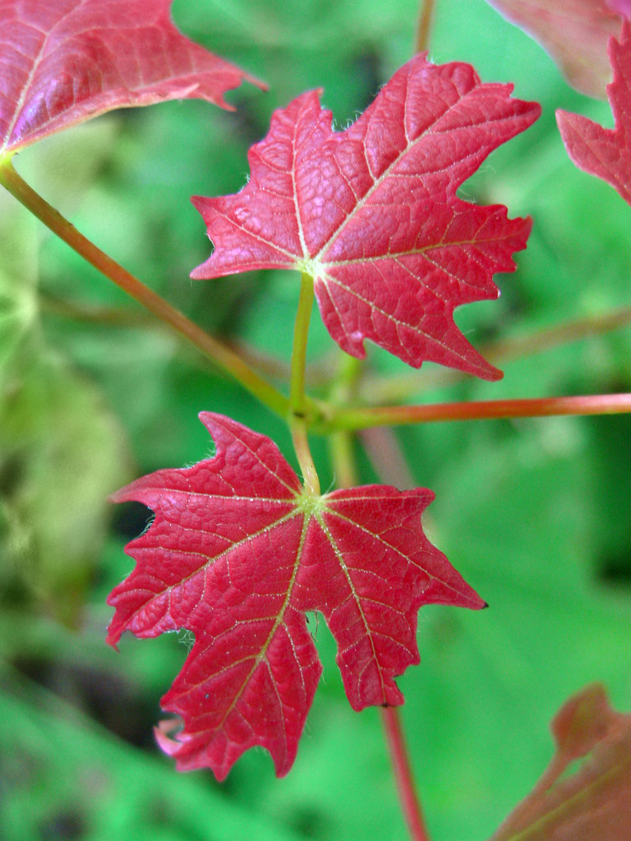
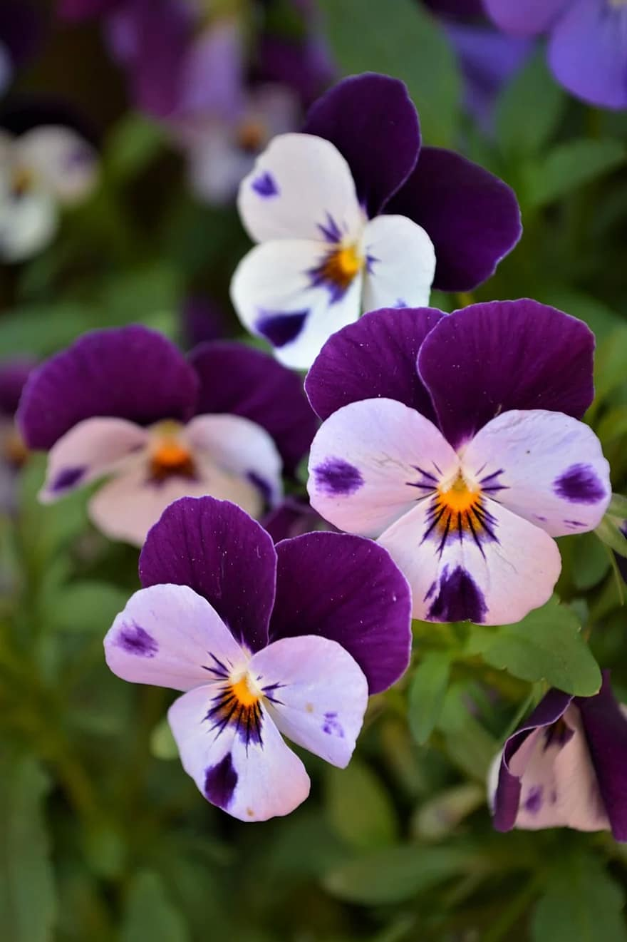
Guess That Plant
Use the sheet attached to your activity package and the clues provided to discover each plant
Sugar Maple
Witch-hazel
White Pine
Pansy
Dogwood
Sugar maple
HINT: It’s a pretty sweet plant
HINT: It’s a great Halloween costume
HINT: A character with 7 Dwarves
HINT:This plant is not cowardly
HINT: It’s got a pretty loud bark
Witch hazel
White pine
Pansy
Dogwood
acer saccharum
hamamelis sp.
pinus stobus
viola tricolor
cornus sericea

